Slide 1
Transformation Jeopardy
Reflections | Rotations | Translations | Dilations | Symmetry | Mixed
1 | 1 | 1 | 1 | 1 | 1
2 | 2 | 2 | 2 | 2 | 2
3 | 3 | 3 | 3 | 3 | 3
4 | 4 | 4 | 4 | 4 | 4

Slide 2
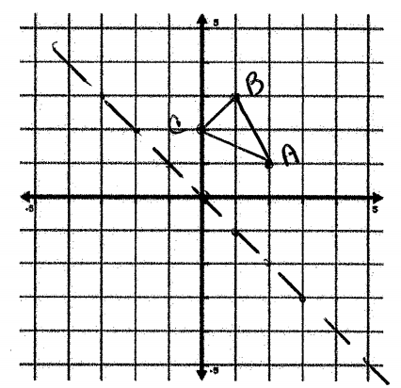
Reflections 1
State the coordinates of C’:

Slide 3
Reflections 1 ANSWER
C’ = (-2, 0)

Slide 4
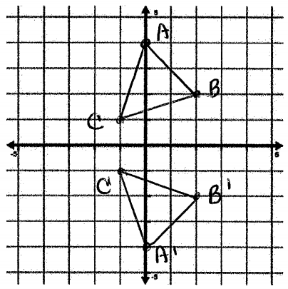
Reflections 2
Name the line of reflection:

Slide 5
Reflections 2 ANSWER
x axis

Slide 6
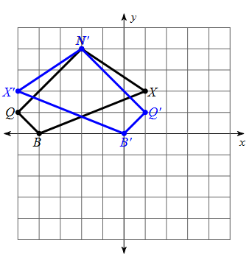
Reflections 3
Name the line of reflection:

Slide 7
Reflections 3 ANSWER
x = -2

Slide 8
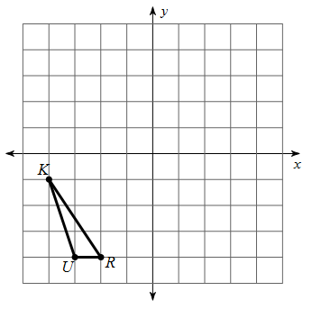
Reflections 4
First reflect over x = -2, then over x = 1.
A. What single transformation would have been the same as these two reflections?

Slide 9
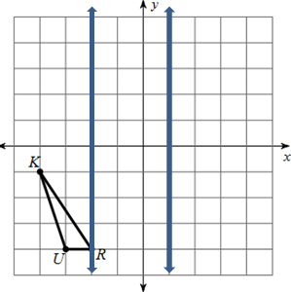
Reflections 4 ANSWER
2 times 3 (distance between parallel lines) = 6,
So a translation of right 6.

Slide 10
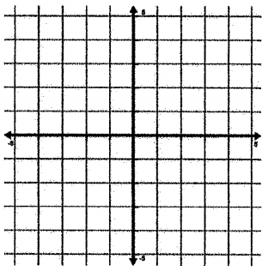
Rotations 1
Emily is planting pumpkins, using a coordinate grid as a guide. She plants a pumpkin at (-3, 2) but then decides to rotate it 180°. Where is the pumpkin now?

Slide 11
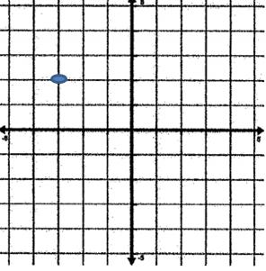
Rotations 1 ANSWER
(3, -2)

Slide 12
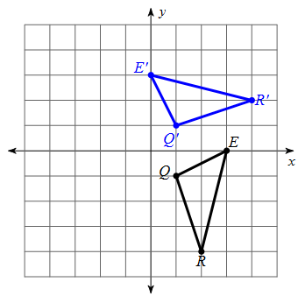
Rotations 2
Describe the rotation:

Slide 13
Rotations 2 ANSWER
90° counterclockwise about (0, 0)

Slide 14
Rotations 3
A is plotted at (5, 4) and is then rotated 90° counterclockwise about the origin and then slid 2 to the right. What are the coordinates of A’’?

Slide 15
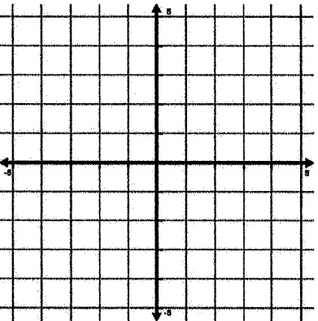
Rotations 3 ANSWER
A’’ (-2, 5)
A is plotted at (5, 4) and is then rotated 90° counterclockwise about the origin and then slid 2 to the right. What are the coordinates of A’’?

Slide 16
Rotations 4
Marcella planted some tomatoes at (2, -4). They were not getting enough sun so Riley advised her to slide them 3 left and then rotate them 90° clockwise about the origin. Where are Marcella’s tomatoes?

Slide 17
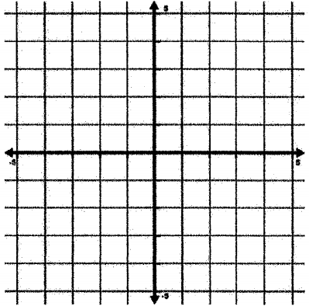
Rotations 4 ANSWER
Marcella planted some tomatoes at (2, -4). They were not getting enough sun so Riley advised her to slide them 3 left and then rotate them 90° clockwise about the origin. Where are Marcella’s tomatoes? (-4, 1)

Slide 18
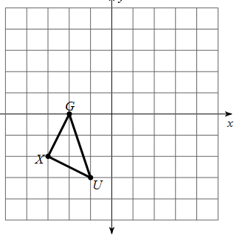
Translations 1
What are the coordinates of G’ under the translation $\left\langle 3, 4\right\rangle ?$

Slide 19
Translations 1 ANSWER
$\left\langle 3, 4\right\rangle$ means go right 3 and up 4. G’ (1, 4)

Slide 20
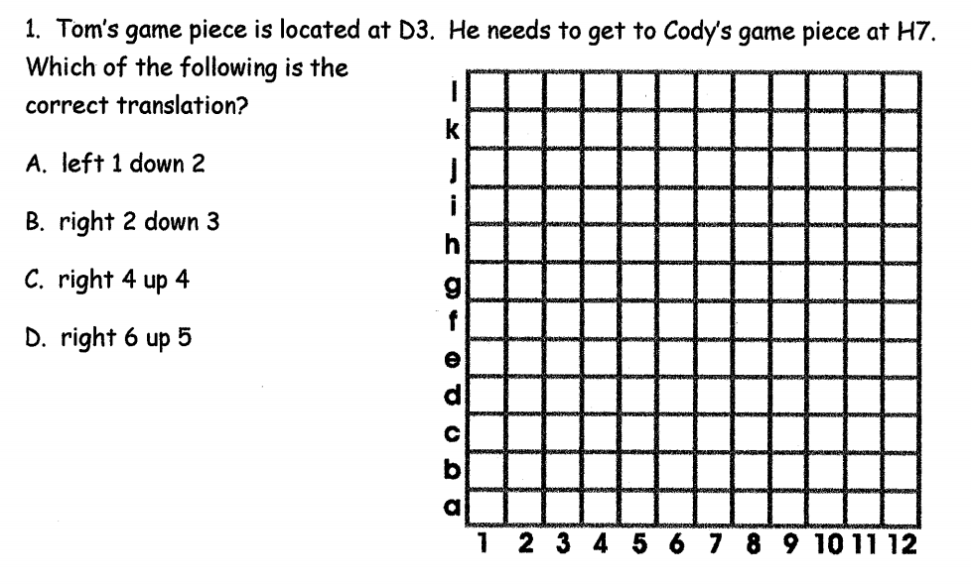
Translations 2
.

Slide 21
Translations 2 ANSWER
C

Slide 22
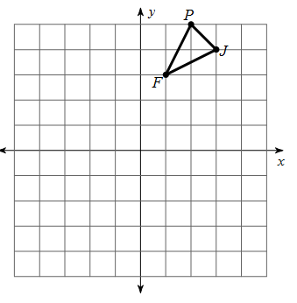
Translations 3
Give the coordinates of P’ under the translation:
(x, y) $→$ (x – 3, y – 6)

Slide 23
Translations 3 ANSWER
Give the coordinates of P’ under the translation:
(x, y) $→$ (x – 3, y – 6) (-1, -1)

Slide 24
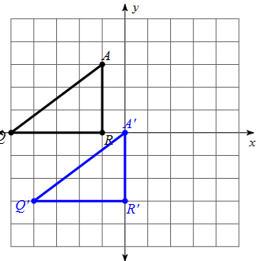
Translations 4
Write a rule in vector notation to describe the translation:

Slide 25
Translations 4 ANSWER
The graph is slid right 1 and down 3
$$\left\langle 1, −3\right\rangle$$

Slide 26
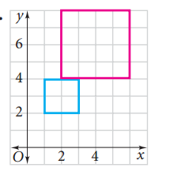
Dilations 1
Find the scale factor:
(The blue is the dilation of the red)

Slide 27
Dilations 1 ANSWER
Scale factor = $\frac{new length}{original length}$ = $\frac{2}{4}$ = $\frac{1}{2}$

Slide 28
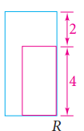
Dilations 2
Find the scale factor and decide if it is an enlargement or reduction. The blue image is the dilation of the red image.

Slide 29
Dilations 2 ANSWER
Scale factor = $\frac{new length}{original length}$ = $\frac{2+4}{4}$ = $\frac{6}{4}$ = $\frac{3}{2}$ = 1.5
enlargement

Slide 30
Dilations 3
Which of the following are preserved in a dilation? Name everything that is true.
Orientation
Angle measure
Distance between points (side lengths)
Shape (parallel sides remain parallel, slopes of sides are unchanged)

Slide 31
Dilations 3 ANSWER
Which of the following are preserved in a dilation? Name everything that is true.
Orientation
Angle measure
Distance between points (side lengths)
Shape (parallel sides remain parallel, slopes of sides are unchanged)

Slide 32
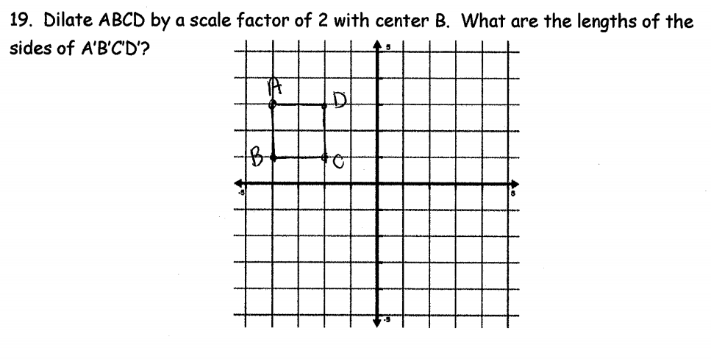
Dilations 4
.

Slide 33
Dilations 4 ANSWER
Side lengths are 4

Slide 34
Symmetry 1
.

Slide 35
Symmetry 1 ANSWER
A. 4
B. 360/4 = 90°
C. 180°, 270°

Slide 36
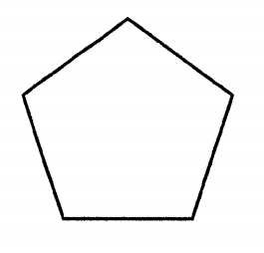
Symmetry 2
.

Slide 37
Symmetry 2 ANSWER
A. 5
B. 360/5 = 72°
C. 144°, 216°, 288°

Slide 38
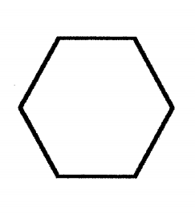
Symmetry 3
.

Slide 39
Symmetry 3 ANSWER
A. 6
B. 360/6 = 60°
C. 120$°$, 180$°$, 240$°$

Slide 40
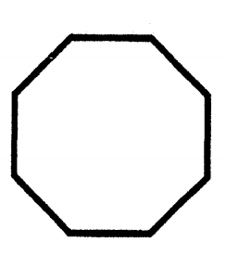
Symmetry 4
.

Slide 41
Symmetry 4 ANSWER
A. 8
B. 360/8 = 45°
C. 90°, 135°, 180°, 225°

Slide 42
Mixed 1
Which of the following side lengths could have had a dilation with scale factor 4?
4, 8
3, 9
5, 20
6, 30

Slide 43
Mixed 1 ANSWER
Which of the following side lengths could have had a dilation with scale factor 4?
4, 8 (8/4 = 2)
3, 9 (9/3 = 3)
5, 20 (20/5 = 4)
6, 30 (30/6 = 5)

Slide 44
Mixed 2
Jacob planted some green peppers at (5, -6). Hannah moved them to the right 3 and up 7. Where are the peppers now?

Slide 45
Mixed 2 ANSWER
Jacob planted some green peppers at (5, -6). Hannah moved them to the right 3 and up 7. Where are the peppers now?
5 + 3 = 8 -6 + 7 = 1
(8, 1)

Slide 46
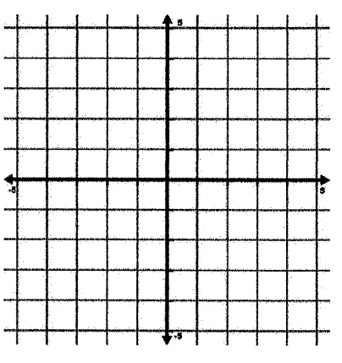
Mixed 3
.

Slide 47
Mixed 3 ANSWER
.
Reverse the translation: go left 3 and up 1.
(0, 1), (-1, 5), (-3, 3)
Reverse the rotation: go 270° clockwise
(-1,0), (-5, -1), (-3, -3)

Slide 48
Mixed 4
.

Slide 49
Mixed 4 ANSWER
.
Reverse the translation: go 3 right and down 1 (0, 0), (2, 1), (-1, 2)
Reverse the rotation: go 90° clockwise about origin: (0, 0), (2, 1), (1, -2)

