Slide 1
An introduction to Trigonometry

Slide 2
Originated in 3rd century B.C.
From the Greek word
Trigonon (Triangle)
And Metron (Measure)

Slide 3
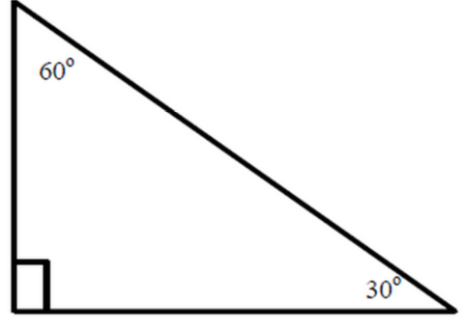
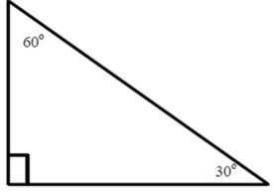
Use 30-60-90 triangles to fill in the missing lengths:
20
16
4
8
10
2
2$\sqrt{3}$
8$\sqrt{3}$
10$\sqrt{3}$

Slide 4
Some definitions
Opposite: not touching/across from
Adjacent: touching/next to
Hypotenuse: longest side, opposite the 90° angle
hypotenuse
Opposite to 30°
Adjacent to 30°

Slide 5
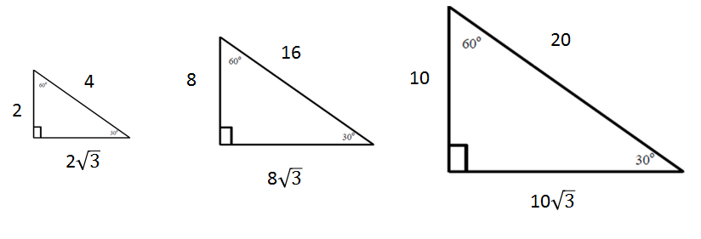

Some patterns…
$$\frac{opposite to 30}{hyoptenuse}$$
$\frac{2}{4}$ = $\frac{8}{16}$ = $\frac{10}{20}$ =
0.5
0.5
0.5

Slide 6
The sine ratio
Mathematicians noticed that no matter how big or small the triangle is, $\frac{opposite to 30}{hyoptenuse}$ was always 0.5!
The ratio $\frac{opposite}{hypotenuse}$ was given the name SINE.
We use sin for short.
Lets see some more patterns…

Slide 7

$$\frac{adjacent to 30°}{hypotenuse}$$
$\frac{2\sqrt{3}}{4}$ = $\frac{8\sqrt{3}}{16}$ = $\frac{10\sqrt{3}}{20}$ =
0.866
0.866
0.866

Slide 8
The cosine ratio
So now we noticed that no matter the size of the triangle $\frac{adjacent to 30}{hypotenuse}$ is always 0.866!
The ratio $\frac{adjacent }{hypotenuse}$ was given the name COSINE. We use cos for short.
There’s one more pattern…

Slide 9

$$\frac{opposite to 30°}{adjacent to 30°}$$
$\frac{2}{2\sqrt{3}}$ = $\frac{8}{8\sqrt{3}}$ = $\frac{10}{10\sqrt{3}}$ =
0.577
0.577
0.577

Slide 10
The tangent ratio
So no matter the size of the triangle, we noticed that $\frac{opposite to 30°}{adjacent to 30°}$ is always 0.577.
The ratio $\frac{opposite }{adjacent }$ was given the name TANGENT.
We use tan for short.

Slide 11
So what did mathematicians do?
Mathematicians began documenting all of the ratios into a table. Eventually they were all stored in calculators for easy access. Try it!
What is sin30 on your calculator?
What is cos30?
What is tan30?
0.5
0.866
0.577

Slide 12
More ratios
What about sin 40?
Sin 40 = 0.643. This means in a right triangle, $\frac{opposite to 40°}{hypotenuse}$ = 0.643. We can use that info to find missing sides and angles in a right triangle.
We could use the decimal, but it is usually much easier to use Sin 40 and use the decimal stored in your calculator.

Slide 13
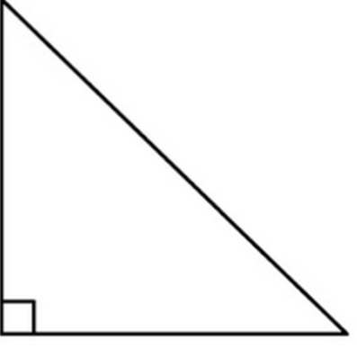
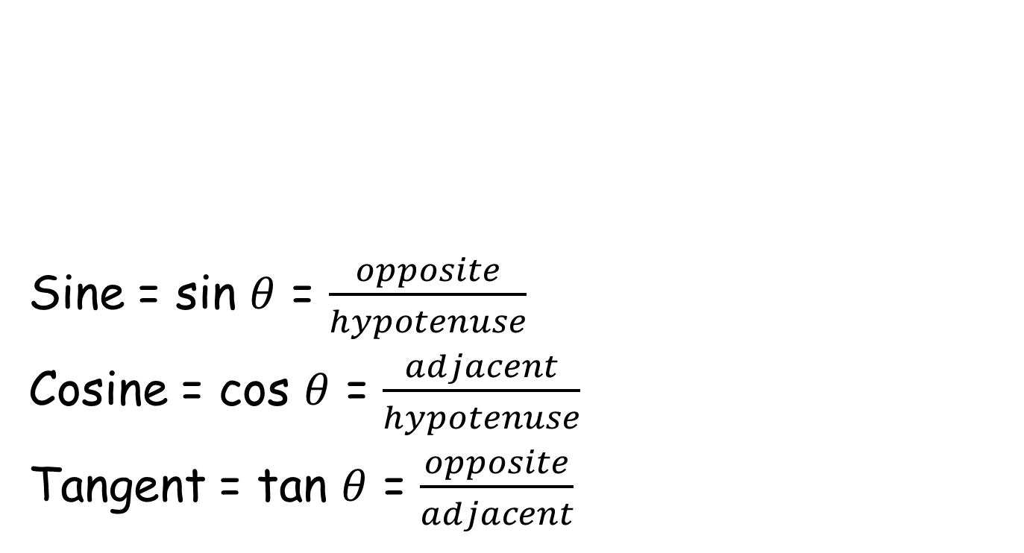
Summary of Formulas
Theta ($θ$) is a Greek letter that is commonly associated with angles
Sine = sin $θ$ = $\frac{opposite}{hypotenuse}$
Cosine = cos $θ$ = $\frac{adjacent}{hypotenuse}$
Tangent = tan $θ$ = $\frac{opposite}{adjacent}$
hypotenuse
What is this??!!?
opposite
$$θ$$
adjacent

Slide 14
How can I remember the formulas?
SohCahToa!
Soh: Sin = $\frac{opp}{hyp}$
Cah: Cos = $\frac{adj}{hyp}$
Toa: Tan = $\frac{opp}{adj}$

Slide 15
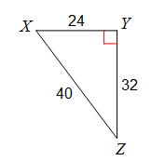







Writing a ratio
Write the ratios for:
Sin X =
Cos X =
Tan X =
Label your triangle!
$\frac{opp}{hyp}$=
$$\frac{32}{40}$$
$$\frac{4}{5}$$
Adjacent to X
$\frac{adj}{hyp}$ =
$$\frac{24}{40}$$
$$\frac{3}{5}$$
Opposite to x
$$\frac{opp}{adj}=$$
$$\frac{32}{24}$$
$$\frac{4}{3}$$
hypotenuse
ALWAYS REDUCE!!!

Slide 16
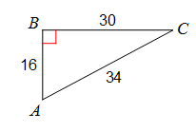
You try it:
Write the ratios for:
Sin A =
Cos A =
Tan A =
$$\frac{15}{17}$$
$$\frac{8}{17}$$
$$\frac{15}{8}$$

Slide 17
YouTube clips:
https://www.youtube.com/watch?v=PIWJo5uK3Fo
https://www.youtube.com/watch?v=4iC-gjKvc7A
https://www.youtube.com/watch?v=t2uPYYLH4Zo

