Slide 1
Geometry Unit 6 Jeopardy
7-6 | 7-7 | 11-1 | 11-2 | 11-3 | 11-4 | 11-5
1 | 1 | 1 | 1 | 1 | 1 | 1
2 | 2 | 2 | 2 | 2 | 2 | 2
3 | 3 | 3 | 3 | 3 | 3 | 3
4 | 4 | 4 | 4 | 4 | 4 | 4
5 | 5 | 5 | 5 | 5 | 5 | 5
final

Slide 2
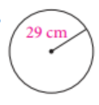
7.6 1
Find the circumference. Leave your answer in terms of $π$. C = $π$d or C = 2$π$r

Slide 3
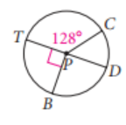
7.6 2
Find the measure of the indicated arc:

Slide 4
7.6 3
Find the measure of the indicated arc:

Slide 5
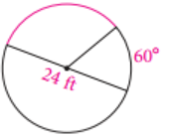
7.6 4
Find the length of the arc shown in red. Leave your answer in terms of $π$.
Arc length: $\frac{arc measure}{360}⋅$2 $π$r

Slide 6
7.6 5
Jessica bakes a cookie with diameter 7 inches. She frosts the edge of the cookie with icing. If Mark cuts a slice that is 75°, what is the length of frosting on his cookie? Round your answer to the nearest tenth.

Slide 7
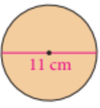
7.7 1
Find the area of the circle. Leave your answer in terms of $π$.
A = $π$r²

Slide 8
7.7 2
If the area of a circle is 64$π$ cm², find the circumference in terms of $π$.
A = $π$r²
C = 2 $π$r

Slide 9
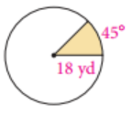
7.7 3
Find the area of the shaded sector. Leave your answer in terms of $π.$
Area of a sector = $\frac{arc measure}{360}$⋅ $π$r²

Slide 10
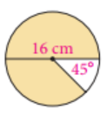
7.7 4
Find the area of the shaded sector. Leave your answer in terms of $π.$
Area of a sector = $\frac{arc measure}{360}$⋅ $π$r²

Slide 11
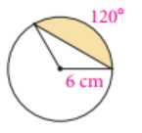
7.7 5
Find the area of the segment:
1. Sector area: area of a sector = $\frac{arc measure}{360}$⋅ $π$r²
Triangle area: A = $\frac{1}{2}$bc(sinA)
Subtract

Slide 12
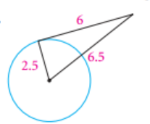
11.1 1
Determine whether the line drawn is a tangent line:

Slide 13
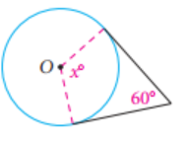
11.1 2
Find the measure of angle x:

Slide 14
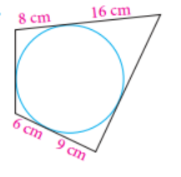
11.1 3
Find the perimeter of the quadrilateral:

Slide 15
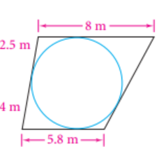
11.1 4
Find the perimeter of the figure:

Slide 16
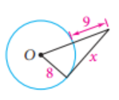
11.1 5
Assume the line drawn is a tangent line. Find the value of x:

Slide 17
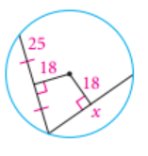
11.2 1
Find the value of x:

Slide 18
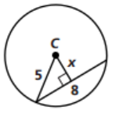
11.2 2
Find the value of x:

Slide 19
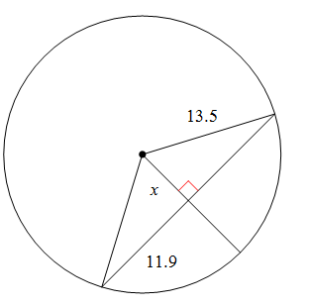
11.2 3
Find the value of x:

Slide 20
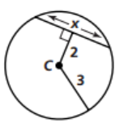
11.2 4
Find the value of x:

Slide 21
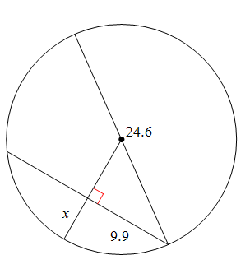
11.2 5
Find the value of x:

Slide 22
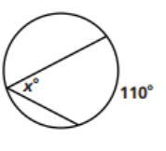
11.3 1
Find the measure of the variable:

Slide 23
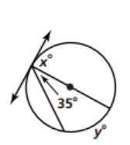
11.3 2
Find the measures of the variables:

Slide 24
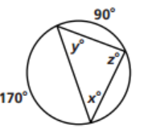
11.3 3
Find the measures of the variables:

Slide 25
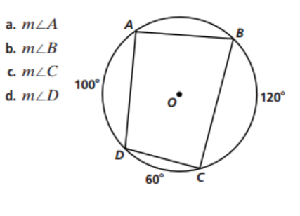
11.3 4
Find the measures of the variables:

Slide 26
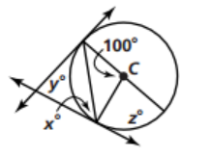
11.3 5
Find the measures of the variables:

Slide 27
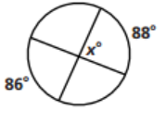
11.4 1
Find the measure of the angle:

Slide 28
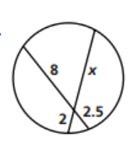
11.4 2
Find the missing segment length:

Slide 29
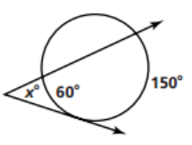
11.4 3
Find the missing angle:

Slide 30
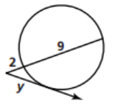
11.4 4
Find the missing segment length:

Slide 31
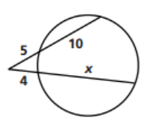
11.4 5
Find the missing segment length:

Slide 32
11.5 1
Identify the center and the radius of the circle:
(x + 8)² + y² = 4

Slide 33
11.5 2
Write the standard form equation for the circle with:
Center (-3, -9)
Radius $\sqrt{15}$

Slide 34
11.5 3
Is the point (-6, 10) on the circle, inside, or outside the circle with equation:
(x + 4)² + (y – 8)² = 9
Explain why!

Slide 35
11.5 4
Write the standard form of a circle that has center (7, -2) and passes through point (-1, -6)

Slide 36
11.5 5
Write an equation for a circle that has center (0, -4) and diameter 6.

Slide 37
7.6 1 ANSWER
Find the circumference. Leave your answer in terms of $π$. C = $π$d or C = 2$π$r
r = 29
C = 2$π$r
C = 2$π29$
C = 58 $π$ cm

Slide 38
7.6 2 ANSWER
$\hat{CD}$: 180 – 128 = 52$°$

Slide 39
7.6 3 ANSWER
$\hat{CBD}$: 128 + 180 = 308°

Slide 40
7.6 4 ANSWER
Arc length: $\frac{arc measure}{360}⋅$2 $π$r
Arc measure: 180 – 60 = 120
Radius = 12
$\frac{120}{360}$⋅2$π$12 = 8$π$ ft

Slide 41
7.6 5 ANSWER
Arc length: $\frac{arc measure}{360}⋅$2 $π$r
Jessica bakes a cookie with diameter 7 inches. She frosts the edge of the cookie with icing. If Mark cuts a slice that is 75°, what is the length of frosting on his cookie? Round your answer to the nearest tenth.
Radius = 3.5
$\frac{75}{360}$*2$π\left(3.5\right)$ = 4.6 inches

Slide 42
7.7 1 ANSWER
A = $π$r²
Radius = 5.5
A = $π(5.5)$²
A = 30.25$π$ cm²

Slide 43
7.7 2 ANSWER
If the area of a circle is 64$π$ cm², find the circumference in terms of $π$.
A = $π$r² C = 2$π$r
64$π$ = $π$r² C = 2 $π8$
64 = r² (divide by $π$) C = 16$π$ cm
8 = r

Slide 44
7.7 3 ANSWER
Area of a sector = $\frac{arc measure}{360}$⋅ $π$r²
area = $\frac{45}{360}$ ⋅ $π(18)$² = 40.5$π$ yd²

Slide 45
7.7 4 ANSWER
Area of a sector = $\frac{arc measure}{360}$⋅ $π$r²
Arc measure = 360 – 45 = 315
Radius = 8
$\frac{315}{360}$ $π(8)$² = 56$π$ cm²

Slide 46
7.7 5 ANSWER
Sector area: area of a sector = $\frac{arc measure}{360}$⋅ $π$r²
$\frac{120}{360}$ $π(6)$² = 37.7
Triangle area: A = $\frac{1}{2}$bc(sinA)
0.5(6)(6)(sin120) = 15.6
3. 37.7 = 15.6 = 22.1 cm²

Slide 47
11.1 1 ANSWER
Determine whether the line drawn is a tangent line:
2.5² + 6² = 6.5² Right angle?
42.25 = 42.25
Yes the line is a tangent line

Slide 48
11.1 2 ANSWER
*Tangent lines are perpendicular to radius!
90 + 90 + 60 = 240
360 – 240 = 120°

Slide 49
11.1 3 ANSWER
Perimeter (add all sides)
Top: 24
Right: 25
Bottom: 15
Left: 14
Perimeter: 78 cm
$$8$$
16
6
9

Slide 50
11.1 4 ANSWER
2.5
5.5
Top: 8
Left: 6.5
Bottom: 5.8
Right: 7.3
Perimeter: 27.6 m
5.5
1.8
4
1.8

Slide 51
11.1 5 ANSWER
Use Pythagorean theorem:
Hypotenuse = 8 + 9 = 17
8² + x² = 17²
64 + x² = 289
x² = 225 (subtract 64)
x = 15
8

Slide 52
11.2 1 ANSWER
Because the radii are perpendicular to the chords, we know:
Chords are congruent
Chords are bisected
x = 25 + 25 = 50

Slide 53
11.2 2 ANSWER
x² + 4² = 5²
x² + 16 = 25
x² = 9
x = 3

Slide 54
11.2 3 ANSWER
11.9² + x² = 13.5²
141.61 + x² = 182.25
x² = 40.64 (subtract 141.61)
x = 6.4 (square root)

Slide 55
11.2 4 ANSWER
**x is the whole length of the chord!**
1. Redraw the radius to close in the triangle
2² + x² = 3²
4 + x² = 9
x² = 5
x = $\sqrt{5}$ *2
x = 4.47 = 4.5

Slide 56
11.2 5 ANSWER
Diameter = 24.6
Radius = 12.3
9.9² + b² = 12.3²
98.01 + b² = 151.29
b² = 53.28
b = 7.3
x = 12.3 – 7.3 = 5
b

Slide 57
11.3 1 ANSWER
Inscribed angles = $\frac{1}{2}$ intercepted arc
x = 110 ÷ 2 = 55°

Slide 58
11.3 2 ANSWER
x = 180 ÷ 2 = 90°
y = 2(35) = 70°
180

Slide 59
11.3 3 ANSWER
x = 90 ÷ 2 = 45°
z = 170 ÷ 2 = 85°
y = 180 – (45 + 85) = 50°

Slide 60
11.3 4 ANSWER
*opposite angles of a quadrilateral inscribed in a circle are supplementary
$∠A= \frac{1}{2}$(120 + 60) = 90°
$∠B$= $\frac{1}{2}$(100 + 60) = 80°
$∠C$= 180 – 90 = 90°
$∠D$= 180 – 80 = 100°

Slide 61
11.3 5 ANSWER
*central angles = intercepted arc
*inscribed angles = $\frac{1}{2}$ intercepted arc
y = 100°
x = 100 ÷ 2 = 50°
z = 180 – 100 = 80°

Slide 62
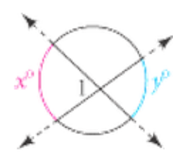
11.4 1 ANSWER
When two chords or secants intersect inside a circle:
x = $\frac{1}{2}$(88 + 86)
x = $\frac{1}{2}$(174)
x = 87°

Slide 63
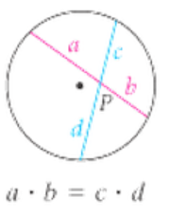
11.4 2 ANSWER
When two chords or secants intersect inside a circle:
2(x) = 8(2.5)
2x = 20
x = 10

Slide 64
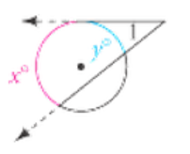
11.4 3 ANSWER
When a secant and a tangent intersect:
x = $\frac{1}{2}$(150-60)
x = $\frac{1}{2}$(90)
x = 45°

Slide 65
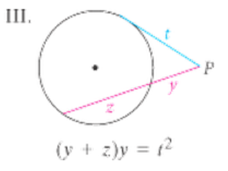
11.4 4 ANSWER
When a secant and a tangent intersect:
2(2 + 9) = y²
2(11) = y²
22 = y²
4.7 = y

Slide 66
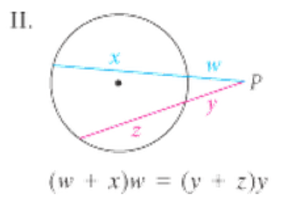
11.4 5 ANSWER
When two secants intersect:
5(5 + 10) = 4(4 + x)
5(15) = 4(4 + x)
75 = 16 + 4x
59 = 4x (subtract 16)
14.75 = x (divide by 4)

Slide 67
11.5 1 ANSWER
Standard form equation: (x –h)² + (y –k)² = r²
(x + 8)² + y² = 4
Center (-8, 0)
Radius = $\sqrt{4}$ = 2

Slide 68
11.5 2 ANSWER
(x –h)² + (y –k)² = r²
Center (-3, -9)
Radius $\sqrt{15}$
(x - -3)² + (y - -9)² = $\sqrt{15}$²
(x + 3)² + (y + 9)² = 15

Slide 69
11.5 3 ANSWER
Is the point (-6, 10) on the circle, inside, or outside the circle with equation:
(x + 4)² + (y – 8)² = 9
(-6+4)² + (10 – 8)² = 9
8 = 9
Inside the circle
(the distance from the center to (-6, 10) is less than the length of the radius.)

Slide 70
11.5 4 ANSWER
Write the standard form of a circle that has center (7, -2) and passes through point (-1, -6)
h, k x, y
(x –h)² + (y –k)² = r²
(-1 – 7)² + (-6 - -2)² = r²
80 = r²
(x – 7)² + (y - -2)² = 80
(x – 7)² + (y + 2)² = 80

Slide 71
11.5 5 ANSWER
Write an equation for a circle that has center (0, -4) and diameter 6.
Diameter 6 = radius 3
(x – 0)² + (y + 4)² = 3²
X² + (y + 4)² = 9

Slide 72
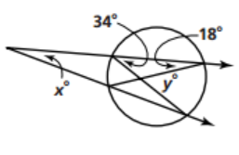
Final Jeopardy
Find the values of x and y:
Hints: inscribed angle = $\frac{1}{2}$intercepted arc

Slide 73
Final Jeopardy ANSWER
x = $\frac{1}{2}$(68-36)=
$\frac{1}{2}$(32) = 16°
Y = $\frac{1}{2}$(68+36)=
= $\frac{1}{2}$(104) = 52°
18*2 = 36
34*2 = 68

