Slide 1
Geometry Unit 5 Jeopardy
Special right Right triangle Right triangle Law Sines Law Cosines Area
Triangles trig trig – sides
1 1 1 1 1 1
2 2 2 2 2 2
3 3 3 3 3 3
4 4 4 4 4 4
5 5 5 5 5 5
Final

Slide 2
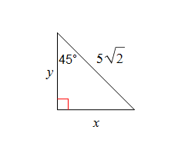
Special Right Triangles 1
Find the missing sides:

Slide 3
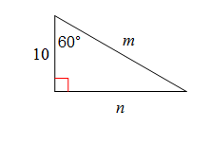
Special Right Triangles 2
Find the missing sides:

Slide 4
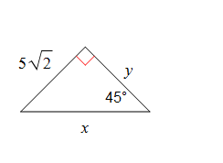
Special Right Triangles 3
Find the missing sides:

Slide 5
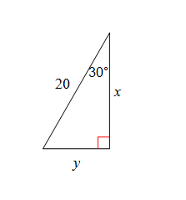
Special Right Triangles 4
Find the missing sides:

Slide 6
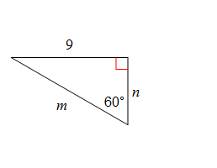
Special Right Triangles 5
Find the missing sides:

Slide 7
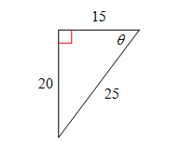
Right Triangle Trig 1
Find the ratios for
Sin $θ$
Cos $θ$
Tan $θ$

Slide 8
Right Triangle Trig 2
What is an equivalent expression to:
Sin75

Slide 9
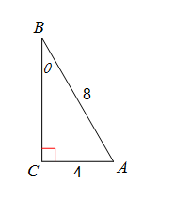
Right Triangle Trig 3
Find the measure of the angle:

Slide 10
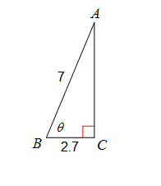
Right Triangle Trig 4
Find the measure of the angle:

Slide 11
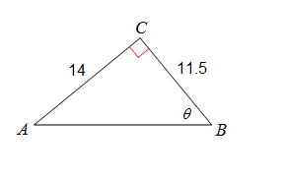
Right Triangle Trig 5
Find the measure of the angle:

Slide 12
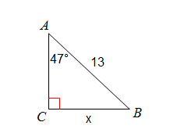
Right Triangle Trig – Sides 1
Solve for x:

Slide 13
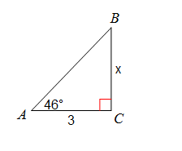
Right Triangle Trig – Sides 2
Solve for x:

Slide 14
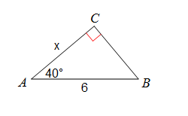
Right Triangle Trig – Sides 3
Solve for x:

Slide 15
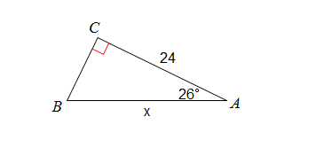
Right Triangle Trig – Sides 4
Solve for x:

Slide 16
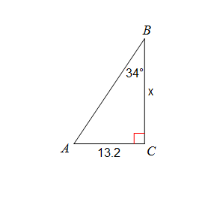
Right Triangle Trig – Sides 5
Solve for x:

Slide 17
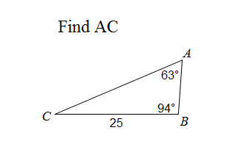
Law of Sines 1
Use the law of sines:

Slide 18
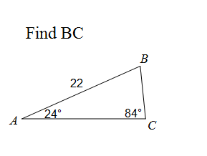
Law of Sines 2
Use the law of sines:

Slide 19
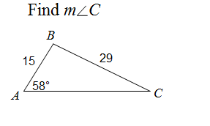
Law of Sines 3
Use the law of sines:

Slide 20
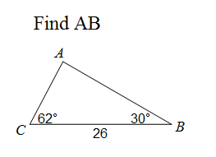
Law of Sines 4
Use the law of sines:

Slide 21
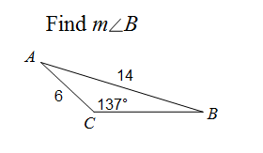
Law of Sines 5
Use the law of sines:

Slide 22
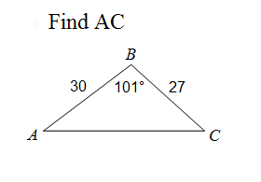
Law of Cosines 1
Use b² = a² + c² – 2ac(cosB):

Slide 23
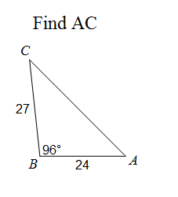
Law of Cosines 2
Use b² = a² + c² – 2ac(cosB):

Slide 24
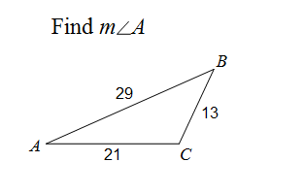
Law of Cosines 3
Use the law of cosines: cosA = $\frac{b^{2}+ c^{2}−a^{2}}{2bc}$

Slide 25
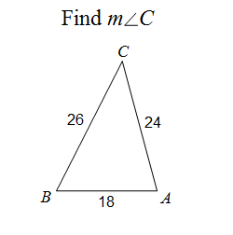
Law of Cosines 4
Use the law of cosines: cosC = $\frac{a^{2}+ b^{2}−c^{2}}{2ab}$

Slide 26
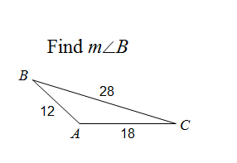
Law of Cosines 5
Use the law of cosines: cosB = $\frac{a^{2}+ c^{2}−b^{2}}{2ac}$

Slide 27
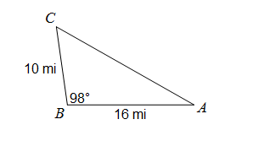
Area 1
Use $\frac{1}{2}$bc(sinA) to find the area of the triangle:

Slide 28
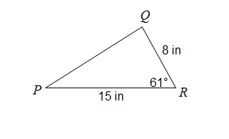
Area 2
Find the area of the triangle:

Slide 29
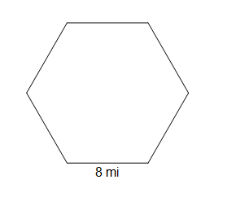
Area 3
Find the area of the hexagon
Use $\frac{1}{2}$ap OR $\frac{1}{2}$bc(sinA)*number of triangles

Slide 30
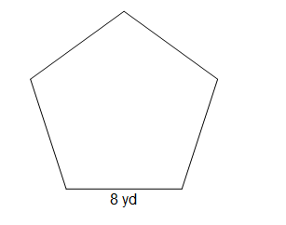
Area 4
Find the area of the pentagon
Use $\frac{1}{2}$ap OR $\frac{1}{2}$bc(sinA)*number of triangles

Slide 31
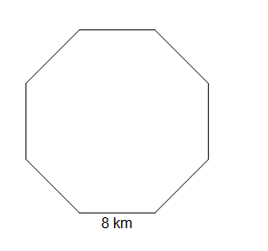
Area 5
Find the area of the octagon
Use $\frac{1}{2}$ap OR $\frac{1}{2}$bc(sinA)*number of triangles

Slide 32
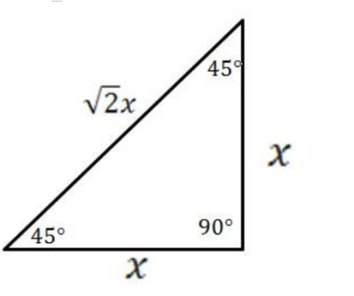
Special Right Triangles Answer 1
$\frac{5\sqrt{2}}{\sqrt{2}}$ = 5 x = 5
y = 5

Slide 33
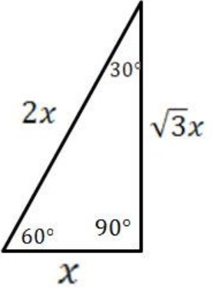
Special Right Triangles Answer 2
m = 2*10 = 20
n = 10$\sqrt{3}$

Slide 34
Special Right Triangles Answer 3
x = 5$\sqrt{2}$ * $\sqrt{2 }$ = 5$\sqrt{4}$= 5(2) = 10
y = 5$\sqrt{2}$

Slide 35
Special Right Triangles Answer 4
y = 20 ÷ 2 = 10
x = 10$\sqrt{3}$

Slide 36
Special Right Triangles Answer 5
n = $\frac{9}{\sqrt{3}}$ = 3$\sqrt{3}$
m = 2* 3$\sqrt{3}$ = 6$\sqrt{3}$

Slide 37
Right triangle trig answer 1
Soh Cah Toa
Sin $θ$= $\frac{20}{25}$ = $\frac{4}{5}$
Cos $θ$ = $\frac{15}{25}$ = $\frac{3}{5}$
Tan $θ$ = $\frac{20}{15}= \frac{4}{3}$

Slide 38
Right triangle trig answer 2
“The sin of A = the cos of the complement of A”
Sin 75 = Cos 15

Slide 39
Right triangle trig answer 3
Sin$θ$ = $\frac{opp}{hyp}$
Sin$θ$ = $\frac{4}{8}$
$θ$ = sin⁻¹ $\frac{4}{8}$
$$θ=30°$$

Slide 40
Right triangle trig answer 4
Cos$θ$ = $\frac{adj}{hyp}$
cos$θ$ = $\frac{2.7}{7}$
$θ$ = cos⁻¹ $\frac{2.7}{7}$
$$θ=67°$$

Slide 41
Right triangle trig answer 5
Tan$θ$ = $\frac{opp}{adj}$
tan$θ$ = $\frac{14}{11.5}$
$θ$ = tan⁻¹ $\frac{14}{11.5}$
$$θ=51°$$

Slide 42
Right triangle trig – sides answer 1
Sin$θ$ = $\frac{opp}{hyp}$
Sin47 = $\frac{x}{13}$
x = 13sin47
x = 9.5

Slide 43
Right triangle trig – sides answer 2
Tan$θ$ = $\frac{opp}{adj}$
Tan 46 = $\frac{x}{3}$
x = 3tan46
x = 3.1

Slide 44
Right triangle trig – sides answer 3
Cos$θ$ = $\frac{adj}{hyp}$
Cos40 = $\frac{x}{6}$
x = 6cos40
x = 4.6

Slide 45
Right triangle trig – sides answer 4
Cos$θ$ = $\frac{adj}{hyp}$
Cos26 = $\frac{24}{x}$
x = $\frac{24}{cos26}$
x = 26.7

Slide 46
Right triangle trig – sides answer 5
Tan$θ$ = $\frac{opp}{adj}$
Tan 34 = $\frac{13.2}{x}$
x = $\frac{13.2}{tan34}$
x = 19.6

Slide 47
Law of sines answer 1
Law of sines:
AC = side b
$\frac{b}{sin94}$ = $\frac{25}{sin63}$cross multiply
b = $\frac{25sin94}{sin63}$
b = 27.989 = 28

Slide 48
Law of sines answer 2
Law of sines:
BC = side a
$\frac{a}{sin24}$ = $\frac{22}{sin84}$ cross multiply
a = $\frac{22sin24}{sin84}$
a =8.997 = 9

Slide 49
Law of sines answer 3
Law of sines:
$\frac{29}{sin58}$ = $\frac{15}{sinC}$ cross multiply
SinC = $\frac{15sin58}{29}$
C = sin⁻¹($\frac{15sin58}{29}$)
C = 26°

Slide 50
Law of sines answer 4
Law of sines:
AB = side c
$∠$A = 180 – (62 + 30) = 88
$\frac{26}{sin88}$ = $\frac{c}{sin62}$ cross multiply
c = $\frac{26sin62}{sin88}$
c =22.97 = 23

Slide 51
Law of sines answer 5
Law of sines:
$\frac{14}{sin137}$ = $\frac{6}{sinB}$ cross multiply
SinB = $\frac{6sin137}{14}$
B = sin⁻¹($\frac{6sin137}{14}$)
B = 17°

Slide 52
Law of Cosines answer 1
Use b² = a² + c² – 2ac(cosB):
b² = 27² + 30² – 2(27)(30)(cos101)
b² = 1938.110573
b = 44.02 = 44

Slide 53
Law of Cosines answer 2
Use b² = a² + c² – 2ac(cosB):
b² = 27² + 24² – 2(27)(24)(cos96)
b² = 1440.468888
b = 37.95 = 38

Slide 54
Law of Cosines answer 3
Use the law of cosines: cosA = $\frac{b^{2}+ c^{2}−a^{2}}{2bc}$
cosA = $\frac{{21}^{2}+{29}^{2}−{13}^{2}}{2(21)(29)}$
cosA = $\frac{1113}{1218}$
A = cos⁻¹($\frac{1113}{1218}$)
A = 24°

Slide 55
Law of Cosines answer 4
Use the law of cosines: cosC = $\frac{a^{2}+ b^{2}−c^{2}}{2ab}$
CosC = $\frac{{26}^{2}+{24}^{2}−{18}^{2}}{2(26)(24)}$
CosC = $\frac{928}{1248}$
C = cos⁻¹($\frac{928}{1248}$)
C = 42°

Slide 56
Law of Cosines answer 5
Use the law of cosines: cosB = $\frac{a^{2}+ c^{2}−b^{2}}{2ac}$
cosB = $\frac{{28}^{2}+ {12}^{2}−{18}^{2}}{2(28)(12)}$
cosB = $\frac{604}{672}$
B = cos⁻¹($\frac{604}{672}$)
B = 26°

Slide 57
Area Answer 1
Use $\frac{1}{2}$bc(sinA) to find the area of the triangle:
A = $\frac{1}{2}$(10)(16)(sin98)
A = 79.2 mi²

Slide 58
Area Answer 2
Use $\frac{1}{2}$bc(sinA) to find the area of the triangle:
A = $\frac{1}{2}$(8)(15)(sin61)
A = 52.5 mi²

Slide 59
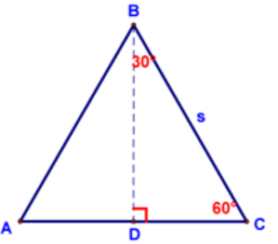
Area Answer 3
Area
Central angle = 360 ÷ 6 = 60
30-60-90: radius = 8
A = $\frac{1}{2}$(8)(8)(sin60)*6
A = 166.3 mi²

Slide 60
Area Answer 4
Find the area of the pentagon
Use $\frac{1}{2}$ap OR $\frac{1}{2}$bc(sinA)*number of triangles
Central angle: 360 ÷ 5 = 72
Radius = 6.8052
A = $\frac{1}{2}$(6.8052)(6.8052)(sin72)*5
A = 110.1 yd²

Slide 61
Area Answer 5
Find the area of the octagon
Use $\frac{1}{2}$ap OR $\frac{1}{2}$bc(sinA)*number of triangles
Central angle: 360 ÷ 8 = 45
Radius = 10.4525
A = $\frac{1}{2}$(10.4525)(10.4525)(sin45)*8
A = 309.019 km²

Slide 62
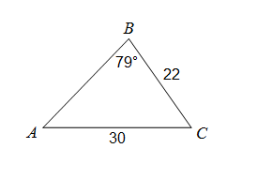
Final Jeopardy
Solve the triangle:

Slide 63
Final Jeopardy answer
Solve the triangle (find all missing measures)
A:
$\frac{30}{sin79}$ = $\frac{22}{sinA}$
A = 46°
C:
180 – (79 + 46) = 55 C = 55°
3. c² = a² + b² – 2ab(cosC):
C² = 22² + 30² – 2(22)(30)(cos55) = 25.03
c = 25

