Slide 1
Geometry Quarter 3 Jeopardy
Circles Mystery Poly Polygon Volume trig
C.P. Area
1 1 1 1 1 1
2 2 2 2 2 2
3 3 3 3 3 3
4 4 4 4 4 4
5 5 5 5 5 5
Final

Slide 2
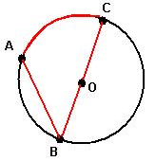
Circles 1
The measure of arc AB = 7$2°$ Find the measure of $∠$ABC

Slide 3
Circles 2
Is the point on the circle, inside, or outside?
(x + 3)² + (y – 8)² = 25
(-6, 12)

Slide 4
Circles 3
Find the measure of x.
**x is NOT a central angle** angle = $\frac{1}{2}$(arc + arc)
35°
x$°$
175°

Slide 5
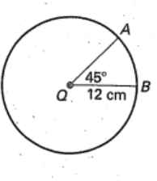
Circles 4
Use the formula: length $\hat{AB}$ = $\frac{m\hat{AB}}{360}$⋅2$π$r
To find the length of arc AB in terms of $π$

Slide 6
Circles 5
Mike and Sean share a 16 inch diameter pizza. Mike has a 100° slice, Sean has a 140° slice. How much more pizza did Sean eat?
Hint: a pizza slice is a sector of a circle:
Area of sector AB = $\frac{m\hat{AB}}{360}$⋅$π$r²

Slide 7
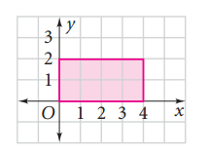
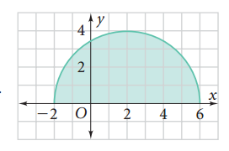
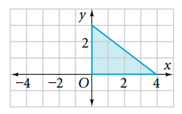
Mystery 1
Solids of revolution: Name the solid that is formed when each shape is rotated around the x-axis:
B. C.

Slide 8
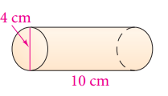
Mystery 2
Find the volume of a cylinder. Leave your answer in terms of $π$.

Slide 9
Mystery 3
The equation of a circle is:
(x – 6)² + (y + 2)² = 64
Identify the center and the diameter.

Slide 10
Mystery 4
Jacob is painting a circular frame that has a 13 inch diameter. Each section will be a different color. One section has an arc measure of 50$°$. How long is this arc to the nearest tenth?
Arc length = $\frac{arc°}{360}$(2$πr)$

Slide 11
Mystery 5
sin 74$°$ = cos ____

Slide 12
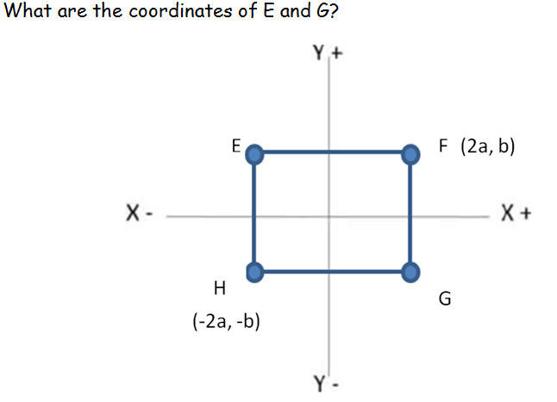
Polygons in Coordinate Plane 1

Slide 13
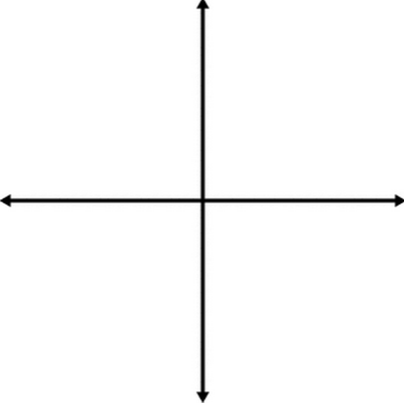
Polygons in Coordinate Plane 2
Name the coordinates of A:
(0, 2b)
(3a, 2b)
(0, 0)
A

Slide 14
Polygons in Coordinate Plane 3
The coordinates of a rectangle are as follows:
(-a, 2b), (a, 2b), (a, -2b). Name the coordinate that is missing.

Slide 15
Polygons in Coordinate Plane 4
A rectangle has coordinates:
A (1, 3), B (2, 5) and D (5, 1) What are the coordinates of C?

Slide 16
Polygons in Coordinate Plane 5
A rectangle has the coordinates:
A (-3, 1)
B (-2, 4)
C (7, 1)
Find D

Slide 17
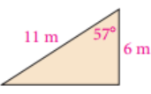
Polygon Area 1
Find the area of the triangle
A = $\frac{1}{2}$bc(sinA)

Slide 18
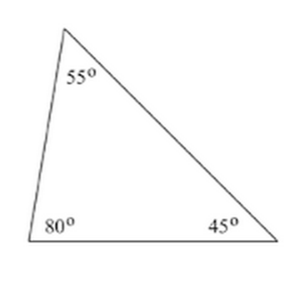
Polygon Area 2
Find the area of the triangle
A = $\frac{1}{2}$bc(sinA)
17 inches
12 inches

Slide 19
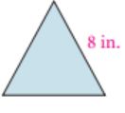
Polygon Area 3
Find the area of the equilateral triangle

Slide 20
Polygon Area 4
Find the area of a hexagon
Each side has a length of 16.5 inches
The apothem is 10.2 inches
A = ½ ap

Slide 21
Polygon Area 5
Mrs. Harris wants to create a bulletin board with shapes. The bulletin board MUST have an area of at most 1000 in². Which of the following shapes could be placed on her board (the shape cannot go outside of the bulletin board!). Explain why!!
Rectangle 48 in by 20 in
Hexagon side length 22 in, apothem 19.1 in
Equilateral triangle side length 48 in

Slide 22
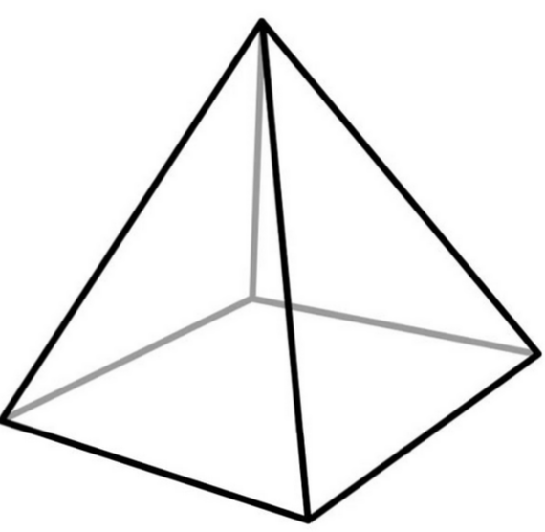
Volume 1
Name the cross section that is perpendicular to the base:

Slide 23
Volume 2
Two cylinders have the same base area. The first cylinder has a height of 8 cm. The second cylinder has a height that is 24 cm taller. How much larger in volume is the second cylinder?

Slide 24
Volume 3
Two pyramids have the same base area. The first pyramid has a height of 6 cm. The second has a height of 42 cm. How much larger in volume is the second pyramid?

Slide 25
Volume 4
A cone and a cylinder have the same base area and the same height.
If you pour one cone of water into the cylinder, how full is it?
If the cylinder is filled with water, how many cones can it fill?

Slide 26
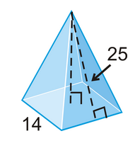
Volume 5
Find the volume of the square pyramid. V = $\frac{1}{3}$Bh
24

Slide 27
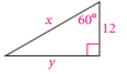
Trig 1
Use special right triangles to solve for x and y. Leave answers in simplest radical form (no decimals!

Slide 28
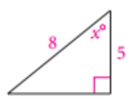
Trig 2
Find the measure of x to the nearest degree:

Slide 29
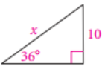
Trig 3
Solve for x to the nearest tenth:

Slide 30
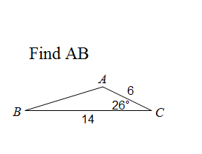
Trig 4
Use the law of cosines: c² = a² + b² – 2ab(cosC)

Slide 31
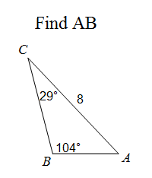
Trig 5
Use the Law of Sines: $\frac{a}{sinA}$ = $\frac{b}{sinB}$ = $\frac{c}{sinC}$

Slide 32
Circles 1 Answer
Arc AC = 180 – 72 = 108°
$∠ABC= \frac{108}{2}$ = 54°

Slide 33
Circles 2 Answer
(x + 3)² + (y – 8)² =25
(-6, 12)
(-6 + 3)² + (12-8)² = 25
25 = 25
ON (the distance between the center and the point is equal to the radius)

Slide 34
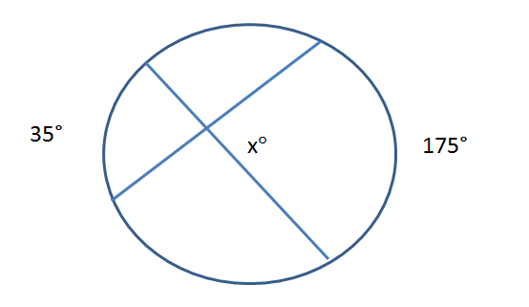
Circles 3 Answer
x = $\frac{1}{2}$(35+175)
X = 105°

Slide 35
Circles 4 Answer
$\hat{AB}$ = $\frac{m\hat{AB}}{360}$⋅2$π$r
$\hat{AB}$ = $\frac{45}{360}$⋅2$π12$
$\hat{AB}$= 3$π$ cm

Slide 36
Circles 5 Answer
Mike and Sean share a 16 inch diameter pizza. Mike has a 100° slice, Sean has a 140° slice. How much more pizza did Sean eat?
Hint: a pizza slice is a sector of a circle:
Area of sector AB = $\frac{m\hat{AB}}{360}$⋅$π$r²
Radius = 8!
$\frac{m\hat{AB}}{360}$⋅$π$r²
Sean: $\frac{140}{360}$⋅$π8$² = 78.2
^{Mike:} $\frac{100}{360}$⋅$π8$² = 55.9
78.2 - 55.9= 22.3 in² more pizza

Slide 37
Mystery 1 Answer
It has perpendicular diagonals.
Cylinder Sphere Cone

Slide 38
Mystery 2 Answer
Cylinder volume: V = $π$r²h
V = $π(2)$²(10)
40$π$ cm³

Slide 39
Mystery 3 Answer
The equation of a circle is:
(x – 6)² + (y + 2)² = 64
Identify the center and the diameter.
(x – h)² + (y – k)² = r²
(h, k) = center, r = radius
Center: (6, -2) r = $\sqrt{64}$ = 8
Diamter = 16

Slide 40
Mystery 4 Answer
Jacob is painting a circular frame that has a 13 inch diameter. Each section will be a different color. One section has an arc measure of 50$°$. How long is this arc to the nearest tenth?
Arc length = $\frac{arc°}{360}$(2$πr)$
Radius = 6.5
$\frac{50}{360}$(2 $π6.5)$ = 5.7 in

Slide 41
Mystery 5 Answer
In a right triangle, the sine of an angle = the cosine of its complement.
sin 74$°$ = cos ____
90 – 74 = 16°

Slide 42
Polygons in C.P. 1 Answer
E = (-2a, b)
G = (2a, -b)

Slide 43
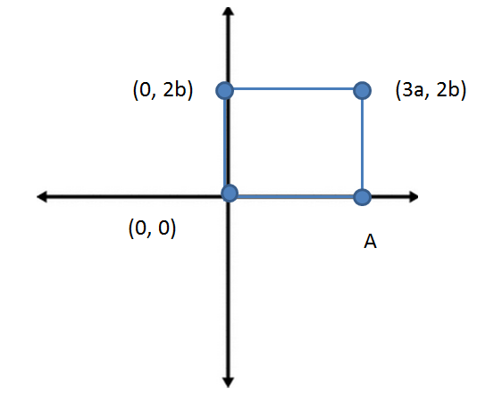
Polygons in C.P. 2 Answer
Name the coordinates of A: (3a, 0)

Slide 44
Polygons in C.P. 3 Answer
The coordinates of a rectangle are as follows:
(-a, 2b), (a, 2b), (a, -2b). Name the coordinate that is missing.
(-a, -2b)

Slide 45
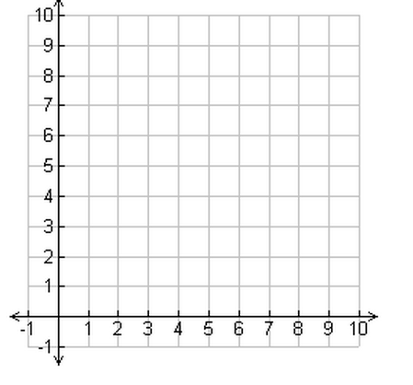
Polygons in C.P. 4 Answer
A rectangle has coordinates:
A (1, 3), B (2, 5) and D (5, 1) What are the coordinates of C?
Slope from A to B = $\frac{2}{1}$
Rectangles have 90° angles!
Slope from D to C = $\frac{2}{1}$
C = (6, 3)

Slide 46
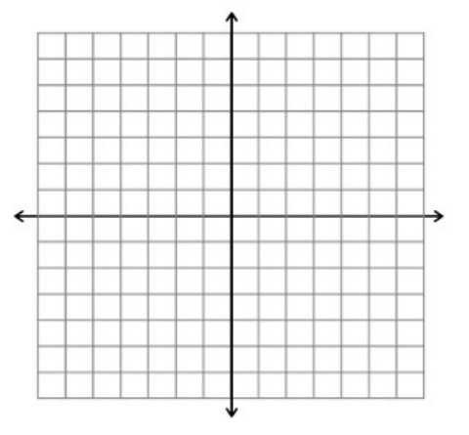
Polygons in C.P. 5 Answer
A rectangle has the coordinates:
A (-3, 1)
B (-2, 4)
C (7, 1)
Find D
Slope from A to B = $\frac{3}{1}$
Slope from D to C must be $\frac{3}{1}$
And the angles must be 90°!
D = (6, -2)

Slide 47
Polygon Area 1 Answer
A = $\frac{1}{2}$bc(sinA)
A = $\frac{1}{2}(11)(6)$(sin57)
A = 27.7 m²

Slide 48
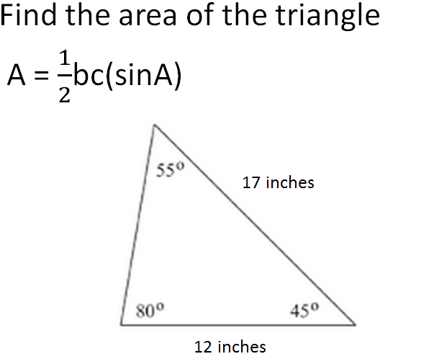
Polygon Area 2 Answer
A = ½ (12)(17)(sin45) = 72.1 in²

Slide 49
Polygon Area 3 Answer
There are several ways to find the area of an equilateral triangle.
Easiest: A = $\frac{1}{2}$bc(sinA)
A = $\frac{1}{2}\left(8\right)\left(8\right)\left(sin60\right)$
A = 27.7 in²

Slide 50
Polygon Area 4 Answer
Find the area of a hexagon
Each side has a length of 16.5 inches
The apothem is 10.2 inches
A = ½ ap a = apothem p = perimeter
a = 10.2
P = 6(16.5) = 99
A = ½ (10.2)(99) = 504.9 in²

Slide 51
Polygon Area 5 Answer
Mrs. Harris wants to create a bulletin board with shapes. The bulletin board MUST have an area of at most 1000 in². Which of the following shapes could be placed on her board (the shape cannot go outside of the bulletin board!). Explain why!!
Rectangle 48 in by 20 in A = 48(20) = 960 in² ☺
Hexagon side length 22 in, apothem 19.1 in
A = ½ (19.1)(22*6) = 1260.6 in² ☹
Equilateral triangle side length 48 in
A = ½ (48)(48)(sin60) = 997.7 in² ☺

Slide 52
Volume 1 Answer
Perpendicular to the base:
Triangle

Slide 53
Volume 2 Answer
Two cylinders have the same base area. The first cylinder has a height of 8 cm. The second cylinder has a height that is 24 cm taller. How much larger in volume is the second cylinder?
First cylinder = 8
Second cylinder = 8 + 24 = 32
32/8 = 4 times as large

Slide 54
Volume 3 Answer
Two pyramids have the same base area. The first pyramid has a height of 6 cm. The second has a height of 42 cm. How much larger in volume is the second pyramid?
First pyramid = 6
Second pyramid = 42
42/6 = 7 times as large

Slide 55
Volume 4 Answer
A cone and a cylinder have the same base area and the same height.
If you pour one cone of water into the cylinder, how full is it? $\frac{1}{3}$
If the cylinder is filled with water, how many cones can it fill? 3

Slide 56
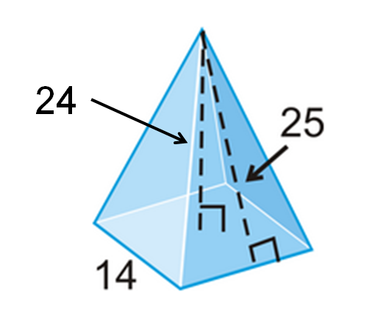
Volume 5 Answer
V = $\frac{1}{3}$Bh
B = base area = 14(14) = 196
h = 24 (25 is slant height ☹ )
V = $\frac{1}{3}\left(196\right)\left(24\right)=1568 units$³

Slide 57
Trig 1 Answer
X = 12(2) = 24
Y = 12*$\sqrt{3}$ = 12$\sqrt{3}$

Slide 58
Trig 2 Answer
Soh Cah Toa
Cos⁻¹ = $\frac{5}{8}$ = 51°

Slide 59
Trig 3 Answer
Soh Cah Toa
Sin 36 = $\frac{10}{x}$
x = 17.0

Slide 60
Trig 4 Answer
Use the law of cosines: c² = a² + b² – 2ab(cosC)
c² = 6² + 14² – 2(6)(14)(cos26)
c² = 81.0026
c = 9

Slide 61
Trig 5 Answer
Use the Law of Sines: $\frac{a}{sinA}$ = $\frac{b}{sinB}$ = $\frac{c}{sinC}$
AB is also called c
$\frac{c}{sin29}$ = $\frac{8}{sin104}$
c = $\frac{8sin29}{sin104}$ = 3.997 = 4

Slide 62
Final Jeopardy
Taylor sees a nest of baby birds in a tree at a 25° angle of elevation. She is standing 12 feet away from the tree. How high in the tree is the nest?

Slide 63
Final Jeopardy Answer
Taylor sees a nest of baby birds in a tree at a 25° angle of elevation. She is standing 12 feet away from the tree. How high in the tree is the nest?
Tan25 = $\frac{x}{12}$ = 5.6 feet
x
25
12

