Slide 1
Algebra Unit 3 Part 1 Jeopardy
1.7 | 1.8 | 2.4 | 2.5 | 2.6 | Mystery
100 | 100 | 100 | 100 | 100 | 100
200 | 200 | 200 | 200 | 200 | 200
300 | 300 | 300 | 300 | 300 | 300
400 | 400 | 400 | 400 | 400 | 400
500 | 500 | 500 | 500 | 500 | 500
Final Jeopardy

Slide 2
1.7 $100
Simplify:
4x² – x²

Slide 3
1.7 $200
Simplify:
-2(3x – 7)

Slide 4
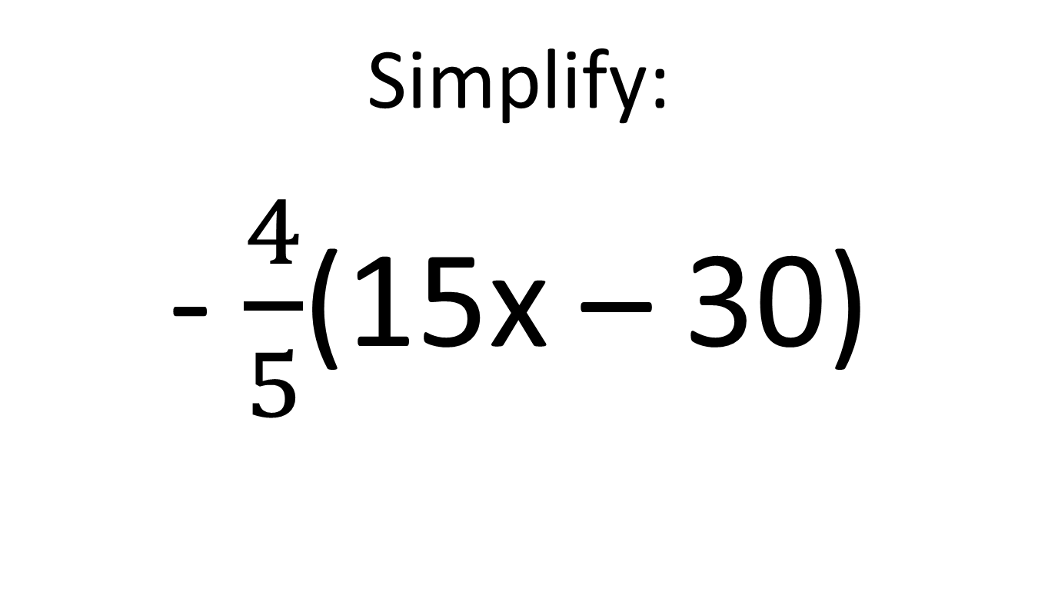
1.7 $300
Simplify:
- $\frac{4}{5}$(15x – 30)

Slide 5
1.7 $400
Which correctly models the distributive property to simplify:
7(91)
7(94 – 3) = 658 – 21 = 637
7(90 – 1) = 630 – 7 = 623
7(90 + 1) = 630 + 7 = 637
7(89 + 2) = 623 + 14 = 637

Slide 6
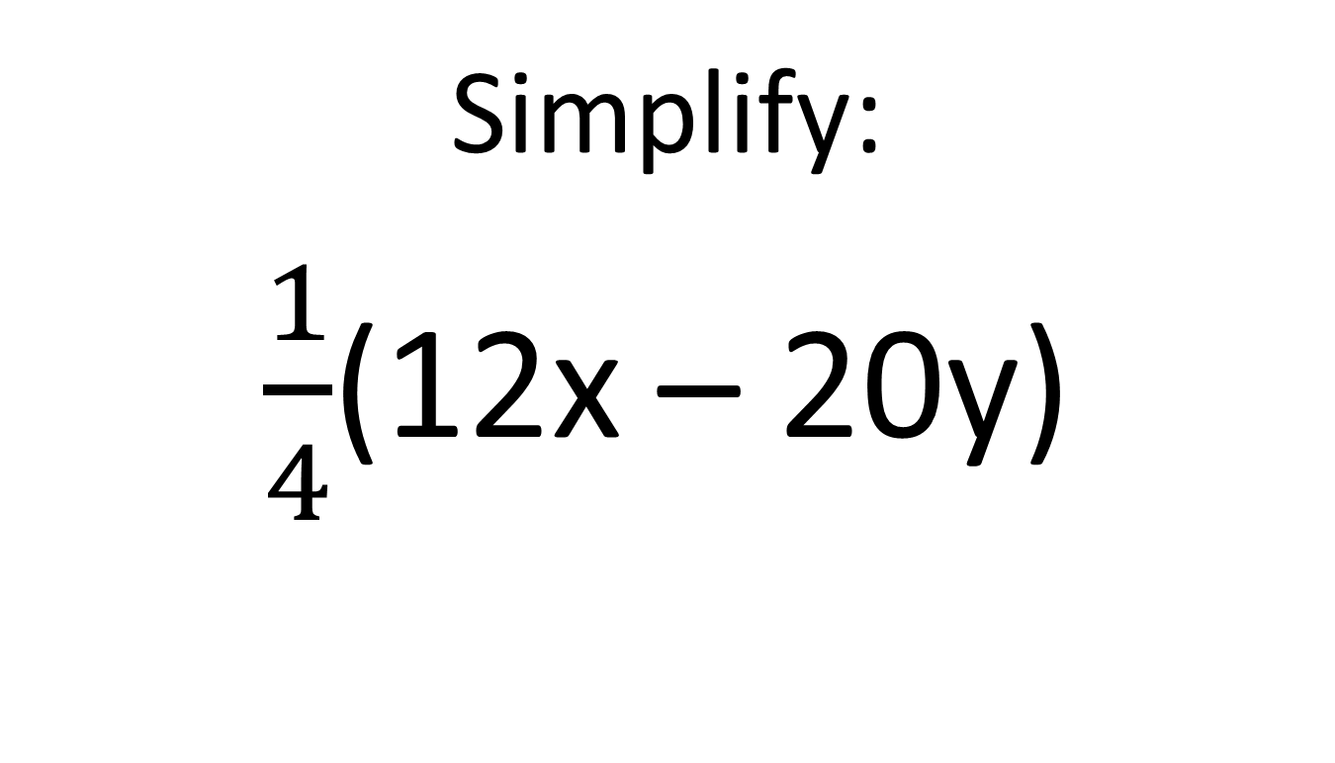
1.7 $500
Simplify:
$\frac{1}{4}$(12x – 20y)

Slide 7
1.8 $100
Name the property illustrated:
-4 + 0 = -4

Slide 8
1.8 $200
Name the property illustrated:
-5 + 5 = 0

Slide 9
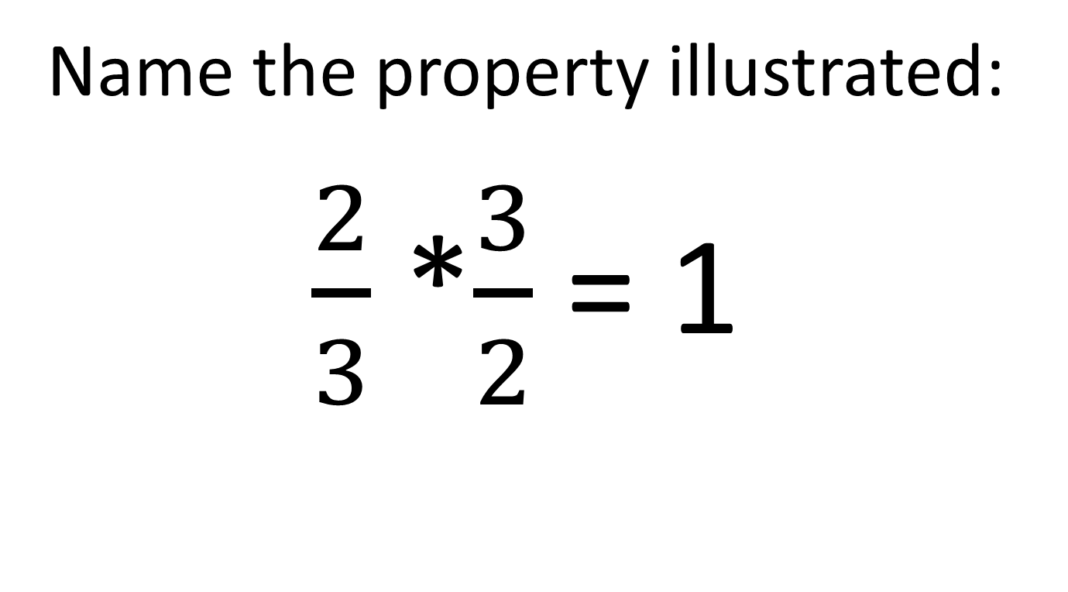
1.8 $300
Name the property illustrated:
$\frac{2}{3}$ *$\frac{3}{2}$ = 1

Slide 10
1.8 $400
Name the properties illustrated:
17(1) = 17
(5⋅6)⋅7 = (5⋅7)⋅6

Slide 11
1.8 $500
Name the properties illustrated:
6(3x – 8) = 6(3x) – 6(8)
(5⋅6)⋅7 = 5⋅(6⋅7)

Slide 12
2.4 $100
Solve:
5x – x + 8 = 32

Slide 13
2.4 $200
Solve:
4(x + 3) = 4x – 12

Slide 14
2.4 $300
Solve:
9x – 14 = 3x + x – 2x

Slide 15
2.4 $400
Tutoring Tommy offers a service where he charges $0.25 per problem he helps you with, plus a $2.75 materials fee for each session. If George paid Tommy $6.00, for how many problems did he get help?
Equation:
Solution:

Slide 16
2.4 $500
Catering by Cayla charges $2.25 per cupcake plus a $10 fee for the delivery. If Ashley spends $93.25, how many cupcakes did she buy?
Equation:
Solution:

Slide 17
2.5 $100
The sum of 3 consecutive integers is -51.
Write an equation to model this situation
What are the three integers?

Slide 18
2.5 $200
The sum of four consecutive even integers is 364.
Write an equation to model this situation
What are the four even integers?

Slide 19
2.5 $300
The length of a garden is 10 more than twice the width. The perimeter of the garden is 56 feet.
Write an equation to model this situation
Find the length and the width

Slide 20
2.5 $400
Michael and Jacob are at Subway. Michael walks north on Van Dyke at 3 mph. Jacob walks south on Van Dyke at 3.4 mph. When will they be 12 miles apart?

Slide 21
2.5 $500
Gabriella and Ashley are shopping at Lakeside Mall. Gabriella finishes shopping at 2:30 and begins to walk home at 3.2 mph. 15 minutes later Ashley realizes she has her cell phone and walks at 4.2 mph to catch up to her. At what time will she catch up with Gabriella?

Slide 22
2.6 $100
Solve for m:
am + bn = p

Slide 23
2.6 $200
Solve for y:
5y = 12x – 30

Slide 24
2.6 $300
Solve for y:
4x – 3y = -18

Slide 25
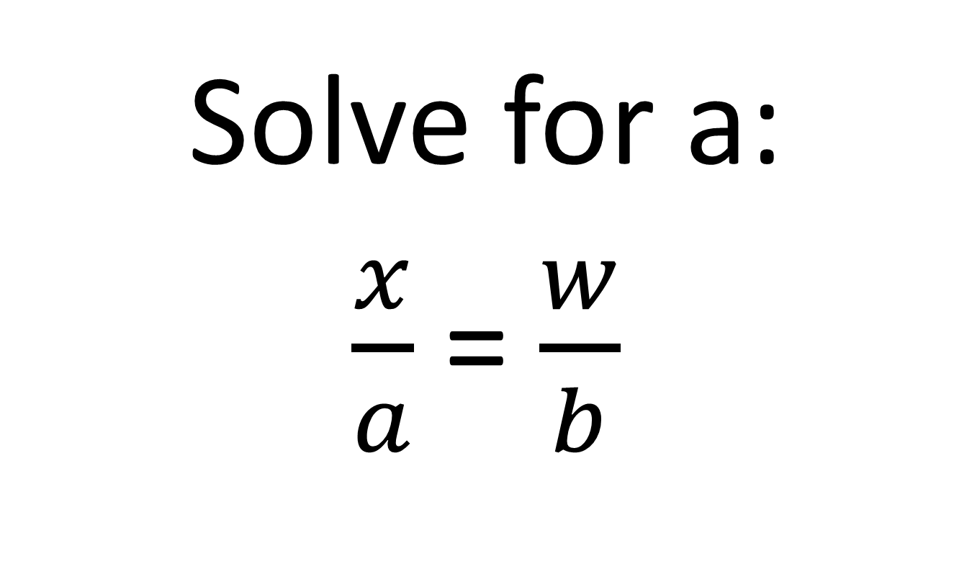
2.6 $400
Solve for a:
$\frac{x}{a}$ = $\frac{w}{b}$

Slide 26
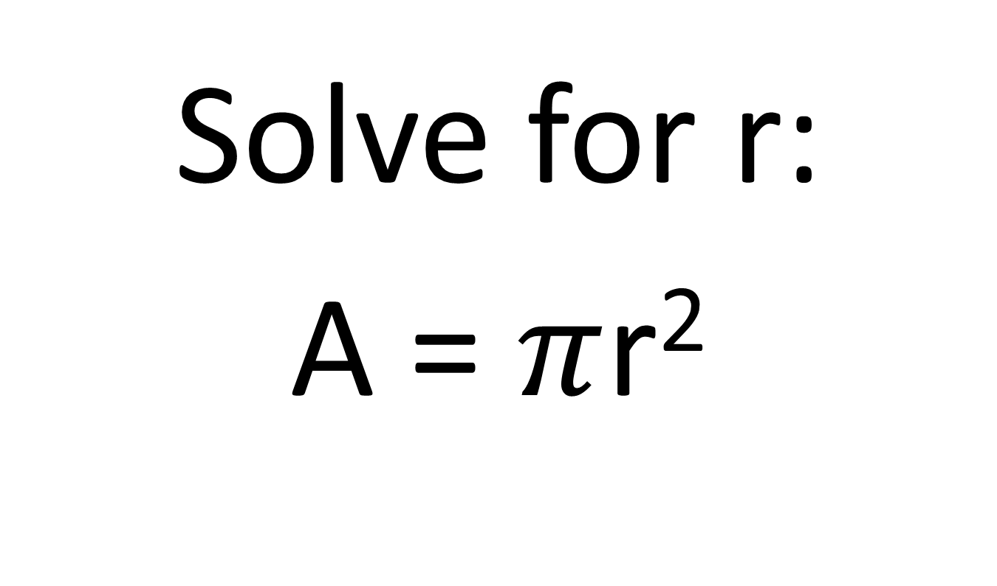
2.6 $500
Solve for r:
A = $π$r²

Slide 27
Mystery $100
Solve:
4(3x – 2) = 16

Slide 28
Mystery $200
4x – 2 = 2x – 4

Slide 29
Mystery $300
5(x – 6) = -30 + 5x

Slide 30
Mystery $400
Which does not have 5 as a solution?
4x + 8 = 28
5x – 2x = x + 10
3(x – 8) = -9
3x + 6 = x + 10

Slide 31
Mystery $500
6x – 3(2x – 1) = 10x – 4x + 2(4 – 3x)

Slide 32
1.7 $100 ANSWER
Simplify:
4x² – x²
3x²

Slide 33
1.7 $200 ANSWER
Simplify:
-2(3x – 7)
-6x + 14

Slide 34
1.7 $300 ANSWER
Simplify:
$\frac{4}{5}$(15x – 30)
-12x + 24

Slide 35
1.7 $400 ANSWER
Which correctly models the distributive property to simplify:
7(91)
7(94 – 3) = 658 – 21 = 637
7(90 – 1) = 630 – 7 = 623
7(90 + 1) = 630 + 7 = 637
7(89 + 2) = 623 + 14 = 637

Slide 36
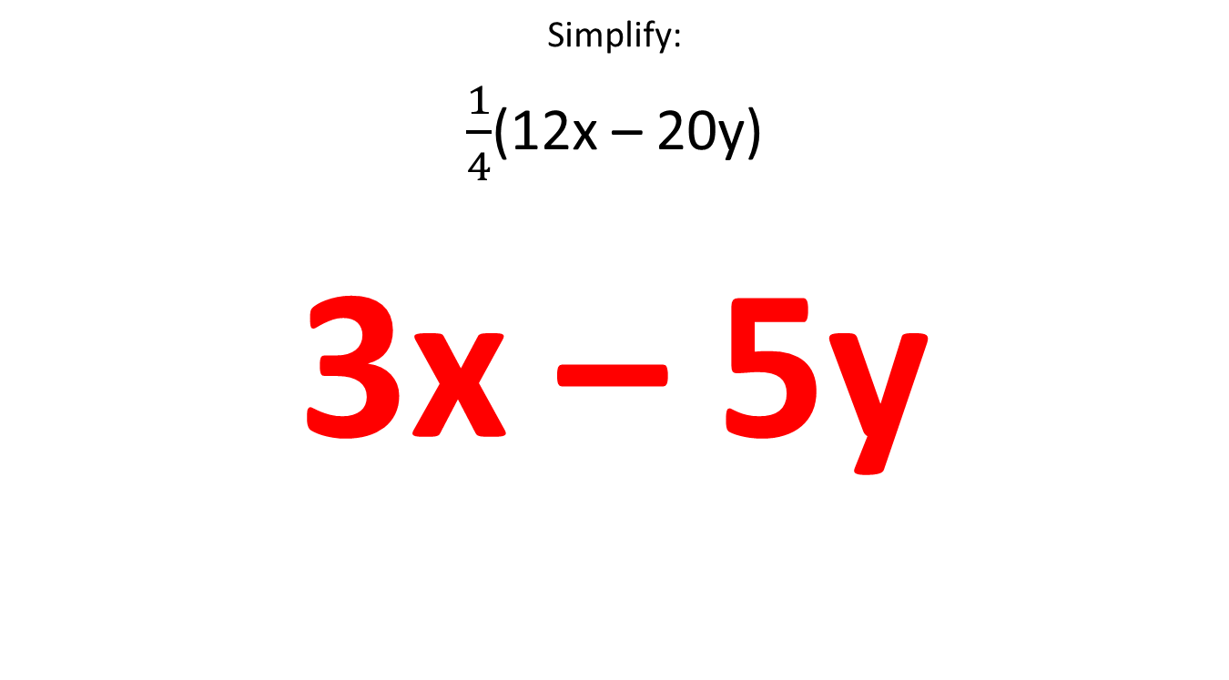
1.7 $500 ANSWER
Simplify:
$\frac{1}{4}$(12x – 20y)
3x – 5y

Slide 37
1.8 $100 ANSWER
Name the property illustrated:
-4 + 0 = -4
Identity property of addition

Slide 38
1.8 $200 ANSWER
Name the property illustrated:
-5 + 5 = 0
inverse property of addition

Slide 39
1.8 $300 ANSWER
Name the property illustrated:
$\frac{2}{3}$ *$\frac{3}{2}$ = 1
Inverse property of multiplication

Slide 40
1.8 $400 ANSWER
Name the properties illustrated:
17(1) = 17
(5⋅6)⋅7 = (5⋅7)⋅6
A. Identity property of multiplication
B. Commutative property of multiplication

Slide 41
1.8 $500 ANSWER
Name the properties illustrated:
6(3x – 8) = 6(3x) – 6(8)
(5⋅6)⋅7 = 5⋅(6⋅7)
A. Distributive Property
B. Associative property of multiplication

Slide 42
2.4 $100 ANSWER
5x – x + 8 = 32
4x + 8 = 32 simplify
4x = 24 subtract 8 from both sides
x = 6 divide both sides by 4

Slide 43
2.4 $200 ANSWER
4(x + 3) = 4x – 12
4x + 12 = 4x – 12 use distributive property
12 = -12 subtract 4x from both sides
No solution 12 can never equal -12

Slide 44
2.4 $300 ANSWER
9x – 14 = 3x + x – 2x
9x – 14 = 2x simplify terms on right
-14 = -7x subtract 9x from both sides
2 = x divide both sides by -7

Slide 45
2.4 $400 ANSWER
Tutoring Tommy offers a service where he charges $0.25 per problem he helps you with, plus a $2.75 materials fee for each session. If George paid Tommy $6.00, for how many problems did he get help?
Equation: y = 2.75 + 0.25x; 6 = 2.75 + 0.25x
Solution: x = 13

Slide 46
2.4 $500 ANSWER
Catering by Cayla charges $2.25 per cupcake plus a $10 fee for the delivery. If Ashley spends $93.25, how many cupcakes did she buy?
Equation: y = 2.25x + 10; 93.25 = 2.25x + 10
Solution: x = 37

Slide 47
2.5 $100 ANSWER
The sum of 3 consecutive integers is -51.
Write an equation to model this situation
x + (x + 1) + (x + 2) = -51
3x + 3 = -51
B. What are the three integers?
-18, -17, -16

Slide 48
2.5 $200 ANSWER
The sum of four consecutive even integers is 364.
Write an equation to model this situation
x + (x + 2) + (x + 4) + (x + 6) = 364
4x + 12 = 364
What are the four even integers?
88, 90, 92, 94

Slide 49
2.5 $300 ANSWER
The length of a garden is 10 more than twice the width. The perimeter of the garden is 56 feet.
Write an equation to model this situation
L = 10 + 2w
W = w
2(10 + 2w) + 2(w) = 56
6w + 20 = 56
Find the length and the width
L = 22 feet W = 6 feet

Slide 50
2.5 $400 ANSWER
Michael and Jacob are at Subway. Michael walks north on Van Dyke at 3 mph. Jacob walks south on Van Dyke at 3.4 mph. When will they be 12 miles apart?
Opposite direction: Michael + Jacob = total distance
3x + 3.4x = 12
6.4x = 12
x = 1.875 hours or 1 hour 52.5 minutes
 | Rate | Time | Distance
Michael | 3 | x | 3x
Jacob | 3.4 | x | 3.4x

Slide 51
2.5 $500 ANSWER
Gabriella and Ashley are shopping at Lakeside Mall. Gabriella finishes shopping at 2:30 and begins to walk home at 3.2 mph. 15 minutes later Ashley realizes she has her cell phone and walks at 4.2 mph to catch up to her. At what time will she catch up with Gabriella?
Same direction: distance traveled is the same
3.2x = 4.2(x – 0.25)
3.2x = 4.2x – 1.05
-x = -1.05
X = 1.05 hours = 1 hour 3 minutes. 3:33
 | Rate | Time | Distance
Gabriella | 3.2 | X | 3.2x
Ashley | 4.2 | X – 0.25 | 4.2(x – 0.25)

Slide 52
2.6 $100 ANSWER
Solve for m:
am + bn = p
am = p – bn subtract bn from both sides
m = $\frac{p −bn}{a}$ divide both sides by a

Slide 53
2.6 $200 ANSWER
Solve for y:
5y = 12x – 30
y = $\frac{12}{5}$x – 6 divide each term by 5

Slide 54
2.6 $300 ANSWER
Solve for y:
4x – 3y = -18
-3y = -4x – 18 subtract 4x from both sides
y = $\frac{4}{3}$x + 6 divide each term by -3

Slide 55
2.6 $400 ANSWER
Solve for a:
$\frac{x}{a}$ = $\frac{w}{b}$
bx = aw cross multiply
$\frac{bx}{w}$ = a divide both sides by w

Slide 56
2.6 $500 ANSWER
Solve for r:
A = $π$r²
$\frac{A}{π}$ = r² divide both sides by $π$
$\sqrt{\frac{A}{π}}$ = r square root each side

Slide 57
Mystery $100 ANSWER
Solve:
4(3x – 2) = 16
12x – 8 = 16 distributive property
12x = 24 add 8 to both sides
x = 2 divide both sides by 12

Slide 58
Mystery $200 ANSWER
4x – 2 = 2x – 4
2x – 2 = -4 subtract 2x from each side
2x = -2 add 2 to each side
x = -1 divide both sides by 2

Slide 59
Mystery $300 ANSWER
5(x – 6) = -30 + 5x
5x – 30 = -30 + 5x distributive property
5x – 30 = 5x – 30 commutative property of addition
This is an identity equation – there are infinitely many solutions.

Slide 60
Mystery $400 ANSWER
Which does not have 5 as a solution?
Solve each equation, or plug 5 in for x into each equation
4x + 8 = 28 x = 5
5x – 2x = x + 10 x = 5
3(x – 8) = -9 x = 5
3x + 6 = x + 10 x = 2

Slide 61
Mystery $500 ANSWER
6x – 3(2x – 1) = 10x – 4x + 2(4 – 3x)
6x – 6x + 3 = 6x + 8 – 6x
0x + 3 = 0x + 8
3 = 8
No solution

Slide 62
Final Jeopardy
Hannah and Jennifer take a road trip. They drove 360 miles in 6 hours. Hannah drove first and she averaged 55 mph. Jennifer drove second and averaged 75 mph. For how long did each girl drive?

Slide 63
Final Jeopardy ANSWER
Hannah and Jennifer take a road trip. They drove 360 miles in 6 hours. Hannah drove first and she averaged 55 mph. Jennifer drove second and averaged 75 mph. For how long did each girl drive?
55x + 75(6 – x) = 360
55x + 450 – 75x = 360
-20x + 450 = 360
-20x = -90
x = 4.5
Hannah: 4.5 hours Jennifer 1.5 hours
 | Rate | Time | Distance
Hannah | 55 | x | 55x
Jennifer | 75 | 6 - x | 75(6 – x)

