Slide 1
Algebra Final Exam Jeopardy
Unit 4 | Unit 5 A | Unit 5 B | Unit 6* | mystery
1 | 1 | 1 | 1 | 1
2 | 2 | 2 | 2 | 2
3 | 3 | 3 | 3 | 3
4 | 4 | 4 | 4 | 4
5 | 5 | 5 | 5 | 5
Final Jeopardy

Slide 2
Unit 4 1
y = 3(0.875)^{x}
^{Growth or decay? Why?}

Slide 3
Unit 4 2
y = 0.5(1.25)^{x}
Growth or decay?

Slide 4
Unit 4 3
y = 1.5(0.5)^{X}
State the initial value and the growth/decay factor

Slide 5
Unit 4 4
A town has 4000 people. It loses 2.5% of its population each year. How many people will be left in 80 years?

Slide 6
Unit 4 5
Chris invests $600 at 3% interest compounded monthly.
David invests $600 at 4% interest compounded bi-annually.
How much does each have at the end of 10 years?

Slide 7
Unit 5 A 1
Calculate the minimum value for the function:
f(x) = 3x² – 6x + 10

Slide 8
Unit 5 A 2
Factor completely:
9a⁴ – 16b²

Slide 9
Unit 5 A 3
Rewrite the function in vertex form
y = x² – 6x + 2

Slide 10
Unit 5 A 4
State the x-intercepts for the following function:
y = 5x² – 6x – 2

Slide 11
Unit 5 A 5
The dimensions of a box are: 3 cm, (x + 2) cm, and (x + 4) cm. If the volume of the box is 297 cm³, find the dimensions of all three sides.

Slide 12
Unit 5 B 1
What is the maximum value of the function:
f(x) = -x² + 4

Slide 13
Unit 5 B 2
Simplify the expression:
(5x² – 4x + 7) – (6x² + x – 2)
What are the coefficients?

Slide 14
Unit 5 B 3
Factor completely:
x³ – 4x² – 12x

Slide 15
Unit 5 B 4
A ball is launched, and its path is modeled by the function:
h = -16t² + 20t + 2
Where h is the height of the ball and t is the time in seconds.
What is the maximum height of the ball?

Slide 16
Unit 5 B 5
A ball is launched, and its path is modeled by the function:
h = -16t² + 20t + 2
Where h is the height of the ball and t is the time in seconds.
When does the ball hit the ground?

Slide 17
Unit 6 1
State the end behavior for the following function:
y = 3x⁴ – 4x⁵ + 8x²

Slide 18

Unit 6 2
Simplify:
$$\sqrt{−64}$$

Slide 19
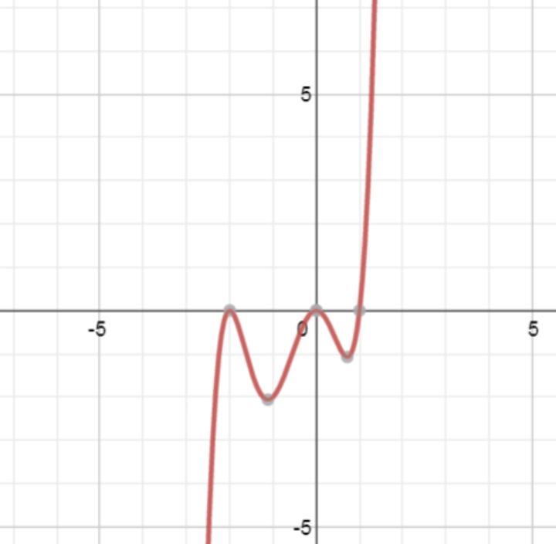
Unit 6 3
Write an equation for the following polynomial. Assume a = 1.

Slide 20
Unit 6 4
Solve the system of functions:
y = x²
y = 10x - 24

Slide 21
Unit 6 5
y = 2(x + 4)(x – 2)²(x + 1)²
What are the crossing zeros?
What are the touching zeros?
What is the y-intercept?
What is the degree of the function?
State the end behavior

Slide 22
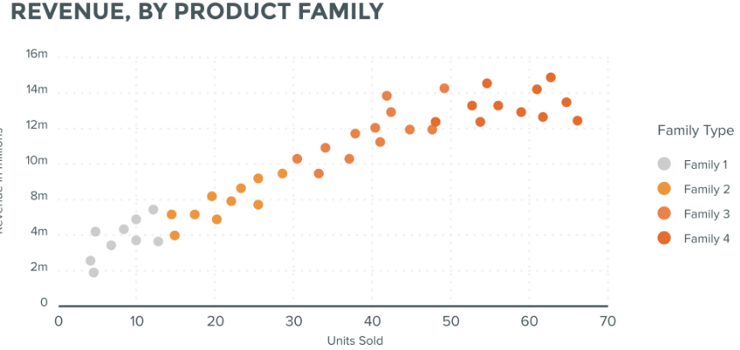
Mystery 1
Estimate the correlation coefficient:
5
2
0.9
-.8

Slide 23

Mystery 2
simplify:
$$\frac{8}{\sqrt{18}}$$

Slide 24
Mystery 3
Solve: 4(x – 2)² = -36

Slide 25
Mystery 4
Daily Double! Worth 8 points!
Find the roots. Leave your answer in simplest radical form.
y = 3x² – 4x – 6

Slide 26
Mystery 5
Solve. Leave answer in simplest radical form.
2x² + 3x – 1 = x² + 5x – 7

Slide 27
Final Jeopardy
You have a rectangle with dimensions x cm and (x + 8) cm. The area of the box is 20 cm. Find the length and width of the rectangle.

Slide 28
Unit 4 1 Answer
y = 3(0.875)^{x}
^{Growth or decay? Why?}
Decay: 0.875 is between 0 and 1

Slide 29
Unit 4 2 Answer
y = 0.5(1.25)^{x}
Growth or decay?
Growth: 1.25 is greater than 1

Slide 30
Unit 4 3 Answer
y = 1.5(0.5)^{X}
State the initial value and the growth/decay factor
Initial value: 1.5
Decay factor: 0.5

Slide 31
Unit 4 4 Answer
A town has 4000 people. It loses 2.5% of its population each year. How many people will be left in 80 years?
100% - 2.5% = 97.5% = 0.975
y= 4000(0.975)⁸⁰
= 528

Slide 32
Unit 4 5 Answer
Chris invests $600 at 3% interest compounded monthly.
David invests $600 at 4% interest compounded bi-annually.
How much does each have at the end of 10 years?
B = P(1 + r)^{t}
B = balance P = principal r = interest rate per period t = number of times compounded
Chris David
P = 600 P = 600
r = 3/12 = .25% or 0.0025 r = 4/2 = 2% or 0.02
t = 12(10) = 120 t = 2(10) = 20
B = 600(1.0025)¹²⁰ B = 600(1.02)²⁰
$809.61 $$891.57

Slide 33
Unit 5 A 1 Answer
Calculate the minimum value for the function:
f(x) = 3x² – 6x + 10
x = $\frac{−b}{2a}$
x = $\frac{6}{2(3)}$ = 1
f(x) = 3(1)² – 6(1) + 10 = 7
Minimum (1, 7)

Slide 34
Unit 5 A 2 Answer
Factor completely:
9a⁴ – 16b²
Difference of two squares: a² – b² = (a+b)(a-b)
(3a² + 4b)(3a² – 4b)

Slide 35
Unit 5 A 3 Answer
Rewrite the function in vertex form (any method)
y = x² – 6x + 2
find vertex
x = $\frac{6}{2(1)}$ = 3
y = 3² – 6(3)+2 = -7
a = 1 vertex (3, -7)
y = (x – 3)² - 7

Slide 36
Unit 5 A 4 Answer
State the x-intercepts for the following function:
y = 5x² – 6x – 2
Quadratic formula $x=\frac{−b±\sqrt{b^{2}−4ac}}{2a}$
x = $\frac{6±\sqrt{{(−6)}^{2}−4(5)(−2)}}{2(5)}$ = $\frac{6±\sqrt{76}}{10}$ = $\frac{6±8.72}{10}$ =
x = 1.472, x = -0.272

Slide 37
Unit 5 A 5 Answer
The dimensions of a box are: 3 cm, (x + 2) cm, and (x + 4) cm. If the volume of the box is 297 cm³, find the dimensions of all three sides.
Volume = L(W)(H)
297 = 3(x + 2)(x + 4)
297 = 3(x² + 6x + 8)
297 = 3x² + 18x + 24
0 = 3x² + 18x – 273
0 = 3(x² + 6x – 91)
0 = (x + 13)(x – 7)
x = -13 (invalid) x = 7
Dimensions: 3, (7 + 2)(7 + 4) = 3 cm, 9 cm, 11 cm

Slide 38
Unit 5 B 1 Answer
What is the maximum value of the function:
f(x) = -x² + 4
x = $\frac{−b}{2a}$ x = $\frac{0}{2(−1)}$ x = 0 f(x) = 0² + 4 = 4
Maximum: (0, 4)

Slide 39
Unit 5 B 2 Answer
Simplify the expression:
(5x² – 4x + 7) – (6x² + x – 2)
-x² – 5x + 9
What are the coefficients? -1 and -5

Slide 40
Unit 5 B 3 Answer
Factor completely:
x³ – 4x² – 12x
GCF: x(x² – 4x – 12)
x(x – 6)(x + 2)

Slide 41
Unit 5 B 4 Answer
A ball is launched, and its path is modeled by the function:
h = -16t² + 20t + 2
Where h is the height of the ball and t is the time in seconds.
What is the maximum height of the ball? VERTEX!!
x = $\frac{−b}{2a}$ x = $\frac{−20}{2(−16)}$ = 0.625
h = -16(.625)² + 20(.625) + 2 = 8.25
Max height = 8.25 feet

Slide 42
Unit 5 B 5 Answer
A ball is launched, and its path is modeled by the function:
h = -16t² + 20t + 2
Where h is the height of the ball and t is the time in seconds.
When does the ball hit the ground? (x – int! – use quadratic formula!)
x = $\frac{−20±\sqrt{{20}^{2}−4(−16)(2)}}{2(−16)}$ x = $\frac{−20±\sqrt{528}}{−32}$ x = $\frac{−20±22.98}{−32}$ x = -0.09, 1.34
Hits ground at 1.34 seconds

Slide 43
Unit 6 1 Answer
State the end behavior for the following function:
y = 3x⁴ – 4x⁵ + 8x²
y = -4x⁵ – 3x⁴ + 8x²
Negative “a” value, degree 5 (odd)
$$↑↓$$
x$→−∞, f(x)→∞$
x$→∞, f\left(x\right)→−∞$

Slide 44

Unit 6 2 Answer
$$\sqrt{−64}$$
i² = -1 $\sqrt{64(−1)}$
$\sqrt{64i^{2}}$
8i

Slide 45
Unit 6 3 Answer
Crossing at 1
Touching at -2, 0
y = x²(x + 2)²(x – 1)

Slide 46
Unit 6 4 Answer
Solve the system of functions:
y = x²
y = 10x - 24
x² = 10x – 24
x² – 10x + 24 = 0
(x – 6)(x – 4) = 0
x – 6 = 0 x – 4 = 0
x = 6 x = 4
(6, 36) (4, 16)

Slide 47
Unit 6 5 Answer
y = 2(x + 4)(x – 2)²(x + 1)²
What are the crossing zeros? x = -4
What are the touching zeros? x = 2, x = -1
What is the y-intercept? y = 2(0+4)(0-2)²(0+1)² = 32
What is the degree of the function? 5
State the end behavior $↓↑$

Slide 48
Unit 7 1 Answer
Estimate the correlation coefficient:
5 impossible to be greater than 1
2 impossible to be greater than 1
0.9
-.8 data was clearly trending positive

Slide 49

Mystery 2 Answer
$\frac{8}{\sqrt{18}}$ $\frac{\sqrt{2}}{\sqrt{2}}$ = $\frac{8\sqrt{2}}{\sqrt{36}}$ = $\frac{8\sqrt{2}}{6}$ = $\frac{4\sqrt{2}}{3}$

Slide 50
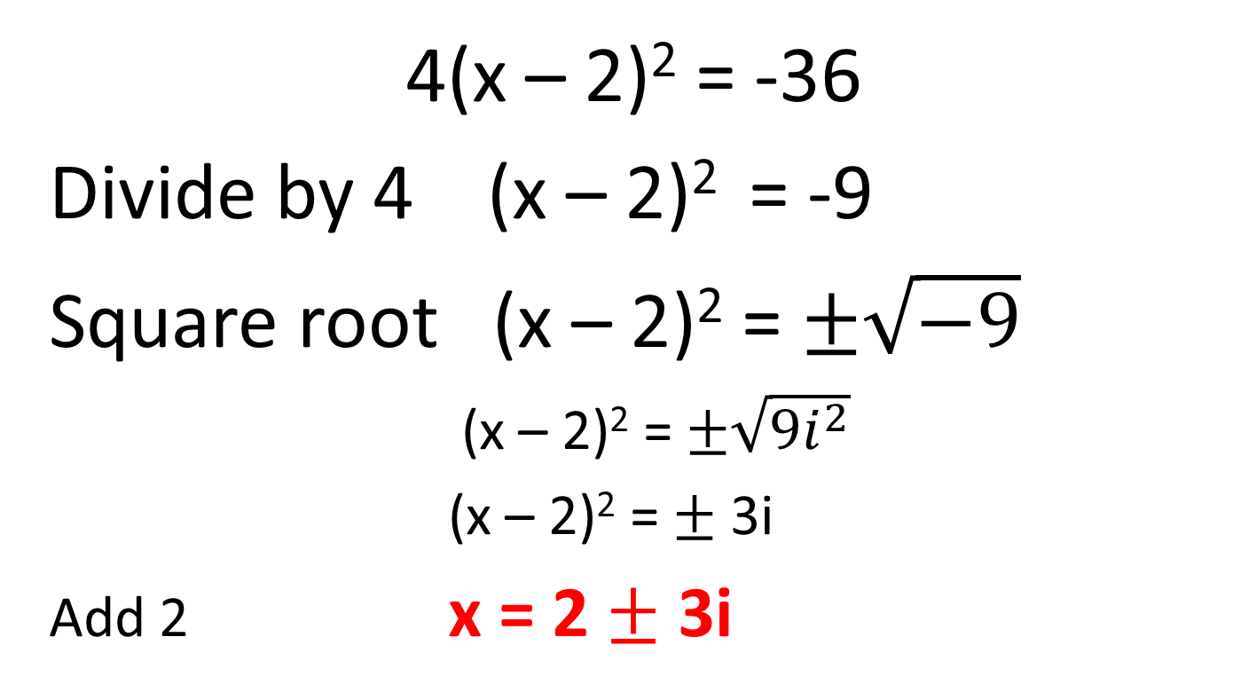
Mystery 3 Answer
4(x – 2)² = -36
Divide by 4 (x – 2)² = -9
Square root (x – 2)² = $±\sqrt{−9}$
(x – 2)² = $±\sqrt{9i^{2}}$
(x – 2)² = $±$ 3i
Add 2 x = 2 $±$ 3i

Slide 51
Mystery 4 Answer
Daily Double! Worth 8 points!
Find the roots. Leave your answer in simplest radical form.
y = 3x² – 4x – 6
Use quad. Formula: x = $\frac{4±\sqrt{{(−4)}^{2}−4(3)(−6)}}{2(3)}$
x = $\frac{4±\sqrt{88}}{6}$ x = $\frac{4±\sqrt{4}\sqrt{22}}{6}$ x = $\frac{4±2\sqrt{22}}{6}$ x = $\frac{2±\sqrt{22}}{3}$

Slide 52
Unit 7 5 Answer
Solve. Leave answer in simplest radical form.
2x² + 3x – 1 = x² + 5x – 7
Standard form: x² – 2x + 6 = 0
Quad. Form: x = $\frac{2±\sqrt{{(−2)}^{2}−4(1)(6)}}{2(1)}$
x = $\frac{2±\sqrt{−20}}{2}$ x = $\frac{2±\sqrt{20i^{2}}}{2}$ x = $\frac{2±2i\sqrt{5}}{2}$ x = 1 $±i\sqrt{5}$

Slide 53
Final Jeopardy Answer
You have a rectangle with dimensions x cm and (x + 8) cm. The area of the box is 20 cm. Find the length and width of the rectangle.
x(x+8) = 20
x² + 8x = 20
x² + 8x – 20 = 0
(x + 10)(x – 2) = 0
x + 10 = 0 x – 2 = 0
x = - 10 x = 2 Dimensions: 2 cm, (2 + 8) =10 cm

