Slide 1
Algebra Chapter 6 Jeopardy
6-1 6-2 6-3 6-4 6-5 MYSTERY
100 100 100 100 100 100
200 200 200 200 200 200
300 300 300 300 300 300
400 400 400 400 400 400
500 500 500 500 500 500
Final Jeopardy
Exit

Slide 2
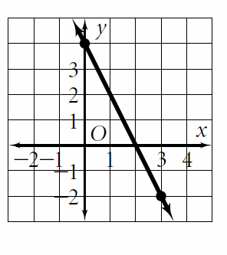
6-1 $100
Calculate the slope of the line:

Slide 3
6-1 $100
Slope = $\frac{rise}{run}$ = $\frac{down 6}{right 3}$ = $\frac{−6}{3}$ = -2

Slide 4
6-1 $200
Calculate the slope:
(-4, -5) (-9, 1)

Slide 5
6-1 $200
M = $\frac{1 −\left(−5\right)}{−9 −(−4)}$ = $\frac{6}{−5}$ = $\frac{−6}{5}$

Slide 6
6-1 $300
Calculate the slope:
(5, -8) (5, -12)

Slide 7
6-1 $300
M = $\frac{−12 −(−8)}{5−5}$ = $\frac{−4}{0}$ =
undefined/no slope

Slide 8
6-1 $400
The slope of a vertical line is ___________
The slope of a horizontal line is _________

Slide 9
6-1 $400
The slope of a vertical line is undefined
The slope of a horizontal line is 0

Slide 10
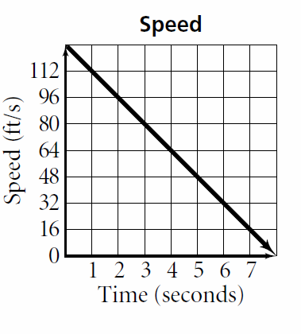
6-1 $500
Calculate the rate of change. Explain what it means.

Slide 11
6-1 $500
Rate of change = $\frac{rise}{run}$ = $\frac{down 16}{right 1}$ = -16
An object is falling 16 feet every second.

Slide 12
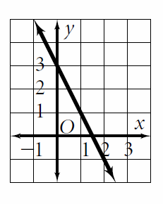
6-2 $100
Write the slope-intercept form of the equation for the line:

Slide 13
6-2 $100
Y-intercept (b) = 3
Slope (m) = $\frac{rise}{run}$ = $\frac{−2}{1}$ = -2
Y = -2x + 3

Slide 14
6-2 $200
Graph the equation:
Y = -x - 2

Slide 15
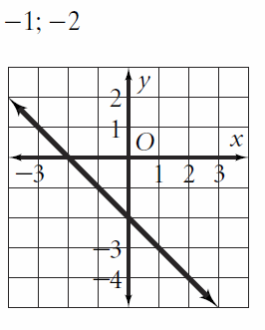
6-2 $200
Y = -x - 2

Slide 16
6-2 $300 Daily Double!
State the slope and y-intercept of the equation:
4x – 2y = -6

Slide 17
6-2 $300
4x – 2y = -6
Solve for y: -4x -4x
-2y = -4x – 6
$÷$-2 $÷$ -2 $÷$-2
y = 2x + 3
Slope = 2
Y-intercept = 3

Slide 18
6-2 $400
Graph the equation:
Y + $\frac{1}{5}$x = -2

Slide 19
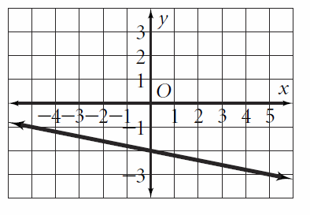
6-2 $400
First solve for y:
Y = - $\frac{1}{5}$ x - 2

Slide 20
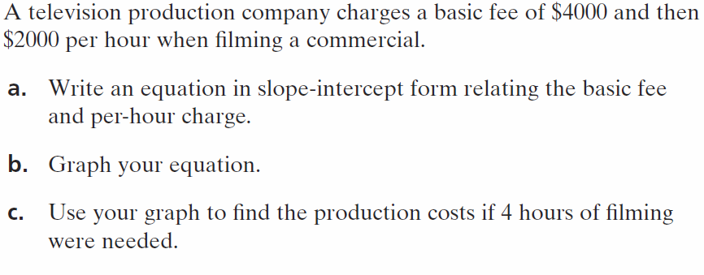
6-2 $500

Slide 21
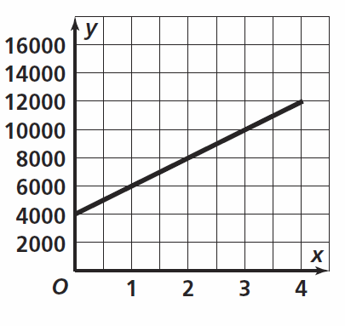
6-2 $500
Y = 2000x + 4000
$12,000

Slide 22
6-3 $100
State the x-and y-intercepts:
5x – 3y = 15

Slide 23
6-3 $100
5x – 3y = 15
($\frac{15}{5}$, 0) = (3, 0)
(0, $\frac{15}{−3}$) = (0, -5)

Slide 24
6-3 $200 Daily Double!
Graph the line using x and y-intercepts
3x – 5y = 15

Slide 25
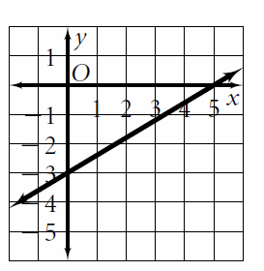
6-3 $200 DailyDouble!
3x – 5y = 15

Slide 26
6-3 $300
Graph
X = -3.5
What is the slope?

Slide 27
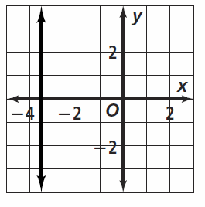
6-3 $300
X = -3.5
The slope is undefined

Slide 28
6-3 $400
Graph
Y = 6
What is the slope?

Slide 29
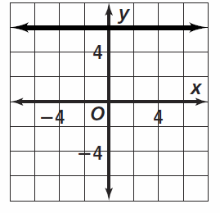
6-3 $400
Y = 6
Slope is 0

Slide 30
6-3 $500
Write an equation in standard form using integers
$\frac{3}{4}$ y = $\frac{2}{3}$ x - 8

Slide 31
6-3 $500
Goal: Ax + By = C $\frac{3}{4}$ y = $\frac{2}{3}$ x - 8
Subtract $\frac{2}{3}$ x: - $\frac{2}{3}$ x + $\frac{3}{4}$ y = -8
Multiply by 12: -8x + 9y = -96
Make sure x is positive: 8x – 9y = 96

Slide 32
6-4 $100
What is the point and slope that was used in the equation:
Y – 4 = -(x + 8)

Slide 33
6-4 $100
Point slope form: y – y = m(x – x)
Y – 4 = -(x + 8)
Point: (-8, 4)
Slope: -1

Slide 34
6-4 $200
Graph the equation:
Y – 5 = $\frac{1}{2}$(x – 2)

Slide 35
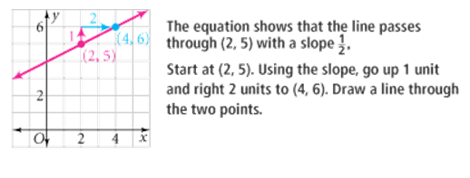
6-4 $200
Y – 5 = $\frac{1}{2}$(x – 2)

Slide 36
6-4 $300
Write an equation in point-slope form for the line that passes through the given point with the given slope:
(-5, 9) m = - $\frac{2}{5}$

Slide 37
6-4 $300
y – y = m(x – x)
Point (-5, 9) m = - $\frac{2}{5}$
y – 9 = - $\frac{2}{5}\left(x −\left(−5\right)\right)$
y – 9 = - $\frac{2}{5}$ (x + 5)

Slide 38
6-4 $400
A line passes through the given points. Write an equation in point slope form:
(-1, -5) (-7, -6)

Slide 39
6-4 $400
Step 1: calculate slope (-1, -5) (-7, -6)
m = $\frac{−6 −(−5)}{−7 −(−1)}$ = $\frac{−1}{−6}$ = $\frac{1}{6}$
Step 2: choose one point and the slope and plug into y – y = m(x – x)
(-1, -5) y – (-5) = $\frac{1}{6}$ (x – (-1))
y + 5 = $\frac{1}{6}$ (x + 1)

Slide 40
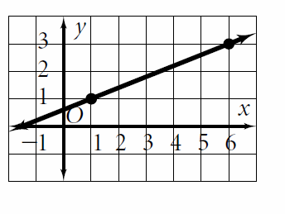
6-4 $500
Write an equation in point slope form:

Slide 41
6-4 $500
Slope = $\frac{rise}{run}$ = $\frac{2}{5}$
Choose (1,1) or (6, 3) and
Substitute into:
y – y = m(x – x)
Y – 1 = $\frac{2}{5}($x – 1) OR y – 3 = $\frac{2}{5}$(x – 6)

Slide 42
6-5 $100
Parallel lines have ______ slopes and _______ y-intercepts. Perpendicular lines have _______ slopes.

Slide 43
6-5 $100
Parallel lines have the same or equal slopes and different y-intercepts. Perpendicular lines have opposite reciprocal slopes.

Slide 44
6-5 $200
State the slope of the line that would be
Parallel
Perpendicular to:
Y = 8

Slide 45
6-5 $200
Y = 8 is a horizontal line with slope = 0
Parallel line would have m = 0
Perpendicular line would be vertical, so slope is undefined.

Slide 46
6-5 $300
Are the lines parallel, perpendicular, or neither? (Show your work!)
8x + 3y = 6
8x – 3y = 6

Slide 47
6-5 $300
Solve each for y:
8x + 3y = 6 8x – 3y = 6
-8x -8x -8x -8x
3y = -8x + 6 -3y = -8x +$6$
Y = - $\frac{8}{3}$ x + 2 y = $\frac{8}{3}$ x – 2
Neither – slopes are not equal or opposite reciprocals.

Slide 48
6-5 $400
Write an equation of a line (in point-slope AND slope intercept form!) that is parallel to the given equation and passes through the given point:
3y = 6x – 9; (6, 4)

Slide 49
6-5 $400
Solve for y: 3y = 6x – 9
y = 2x – 3
Slope = 2; parallel slope = 2 point (6, 4)
Plug into point-slope: y – y = m(x – x)
y – 4 = 2(x – 6)
Now solve for y: y – 4 = 2x – 12
y = 2x – 8

Slide 50
6-5 $500
Write an equation of a line in point slope form that is perpendicular to the given line through the given point.
4x – 2y = 9 (8, -2)

Slide 51
6-5 $500
First solve for y: 4x – 2y = 9
Subtract 4x -2y = -4x + 9
Divide by -2 y = 2x – 4.5
Slope = 2, perpendicular slope = - $\frac{1}{2}$ point (8, -2)
Plug into point slope form: y – y = m(x – x)
y – (-2) = - $\frac{1}{2}$(x – 8)
y + 2 = - $\frac{1}{2}$(x – 8)

Slide 52
MYSTERY $100
GRAPH:
y + 2 = -3(x – 1)

Slide 53
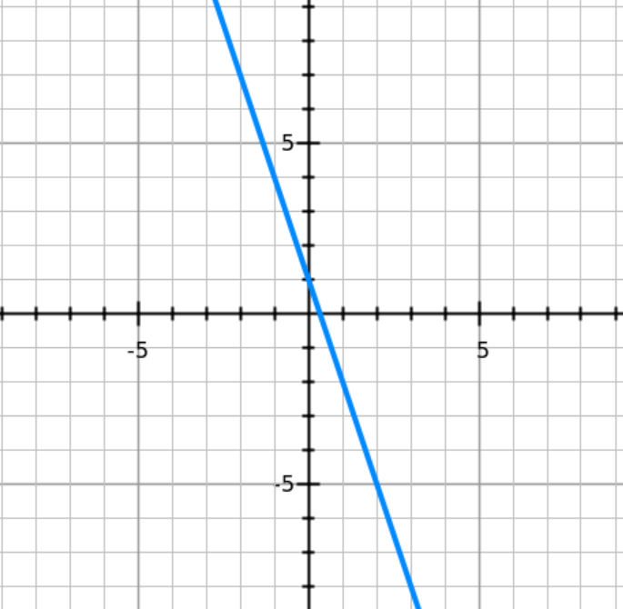
MYSTERY $100

Slide 54
MYSTERY $200
State the slope and y-intercept of the equation:
4y – 5x = 5x + 2

Slide 55
MYSTERY $200
4y – 5x = 5x + 2
+ 5x + 5x
4y = 10x + 2
$÷4$ $÷4$ $÷4$
y = 2.5x + 0.5
Slope = 2.5 y –intercept = 0.5

Slide 56
MYSTERY $300
Write an equation in slope intercept form for the line that is parallel to 3x + 4y = 10 and passes through (-4, 9)

Slide 57
MYSTERY $300
1. Solve the equation for y to determine the slope of the line: 3x + 4y = 10 y = - $\frac{3}{4}$x + 2.5
2. Parallel lines have the same slope – parallel slope will be - $\frac{3}{4}$.
3. Plug in - $\frac{3}{4}$ for m, (-4, 9) for x and y into y = mx + b 9 = - $\frac{3}{4}$(-4) + b
9 = 3 + b
6 = b
y = - $\frac{3}{4}$x + 6

Slide 58
MYSTERY $400
Your school is having a fundraiser to raise money for the math department to buy more calculators. You charge $5 per adult and $3 per student. You have $150 in expenses for putting together the fundraiser. You hope to raise $1000.
Write an equation in standard form to model the situation.
If only students were at the fundraiser, how many would have to come to reach your goal?
If only adults came to the fundraiser how many would have to come to reach your goal?
Where are these values on the graph?

Slide 59
MYSTERY $400
5A + 3S – 150 = 1000
A. 5A + 3S = 1150
383.3 or 384
230
The x and y-intercepts

Slide 60
MYSTERY $500
A line passes through (4, -6) with a slope of $\frac{3}{5}$
Write an equation in point slope form
Write this equation in slope intercept form
Write this equation in standard form using integers

Slide 61
MYSTERY $500
y + 6 = $\frac{3}{5}\left(x −4\right)$
y = $\frac{3}{5}$x – 8$\frac{2}{5}$
3x - 5y = 42

Slide 62
Final Jeopardy
Write an equation of a line that is perpendicular to 6y – 4x = 12 and has the same y-intercept as 3y – 9 = 12x

Slide 63
Final Jeopardy
6y -4x = 12 3y – 9 = 12x
6y = 4x + 12 3y = 12x + 9
Y = $\frac{2}{3}$ x + 2 y = 4x + 3
Slope = $\frac{2}{3}$ y-int = 3
Perpendicular slope - $\frac{3}{2}$
Y = - $\frac{3}{2}$ x + 3

