Slide 1
Geometry Unit 3 Jeopardy
Congruence similarity special segments angles area/pythag.thm.
100 100 100 100 100
200 200 200 200 200
300 300 300 300 300
400 400 400 400 400
500 500 500 500 500
Final

Slide 2
Congruence $100
Name three transformations that result in producing a congruent triangle:

Slide 3
Congruence $100 Answer
Reflection
Rotation
Translation

Slide 4
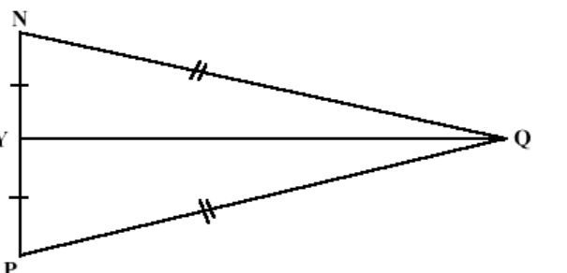
Congruence $200
Are the triangles congruent? If so, name the theorem:

Slide 5
Congruence $200 Answer
Yes, triangles are congruent by SSS

Slide 6
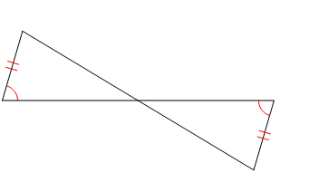
Congruence $300
Are the triangle congruent? If so name the theorem:

Slide 7
Congruence $300 Answer
The triangles are congruent by AAS

Slide 8
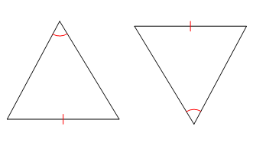
Congruence $400
Are the triangles congruent? If so state the theorem:

Slide 9
Congruence $400 Answer
There is not enough information marked in the picture to determine if triangles are congruent.

Slide 10
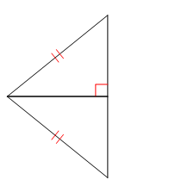
Congruence $500
Are the triangles congruent? If so name the transformation that is modeled, and the theorem:

Slide 11
Congruence $500 Answer
The triangles are reflections, and they are congruent by HL

Slide 12
Similarity $100
When triangles are similar their angles are _____________ (congruent or supplementary),
Their sides are __________ (congruent or proportional), and the transformation that occurred is _________ (rotation or dilation)

Slide 13
Similarity $100 Answer
When triangles are similar their angles are CONGRUENT
Their sides are PROPORTIONAL and the transformation that occurred is a DILATION.

Slide 14
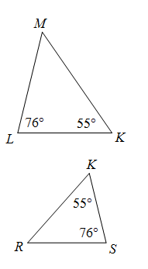
Similarity $200
Are the triangles similar? If so name the theorem:

Slide 15
Similarity $200 Answer
The triangles are similar by AA$\sim$

Slide 16
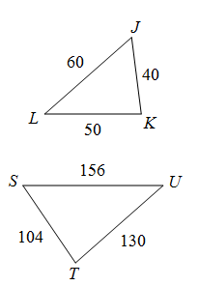
Similarity $300 *Daily Double
Are the triangles similar? If so, name the theorem. *You must explain how you came to this conclusion – which angles are congruent, which sides are (or are not) proportional)

Slide 17
Similarity $300 Answer *Daily Double
The triangles are similar by SSS$\sim$
$$\frac{40}{104}= \frac{5}{13}$$
$\frac{50}{130}$ = $\frac{5}{13}$
$\frac{60}{156}$ = $\frac{5}{13}$

Slide 18
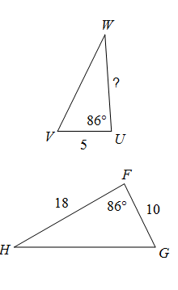
Similarity $400
The triangles are similar. Solve for the ?:

Slide 19
Similarity $400 Answer
$\frac{?}{18}$ = $\frac{5}{10}$
10? = 5(18)
10? = 90
? = 9

Slide 20
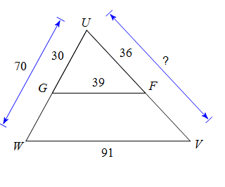
Similarity $500
The triangles are similar. Solve for the ?

Slide 21

Similarity $500 Answer
$\frac{36}{?}$ = $\frac{30}{70}$
30? = 36(70)
30? = 2520
? = 84

Slide 22
Special Segments $100
The medians of a triangle are concurrent at the _____.
The altitudes of a triangle are concurrent at the _____.
The angle bisectors of a triangle are concurrent at the_____.
The perpendicular bisectors of a triangle are concurrent at the ______.
(orthocenter, incenter, circumcenter, centroid)

Slide 23
Special Segments $100 Answer
The medians of a triangle are concurrent at the CENTROID.
The altitudes of a triangle are concurrent at the ORTHOCENTER
The angle bisectors of a triangle are concurrent at the INCENTER
The perpendicular bisectors of a triangle are concurrent at the CIRCUMCENTER

Slide 24
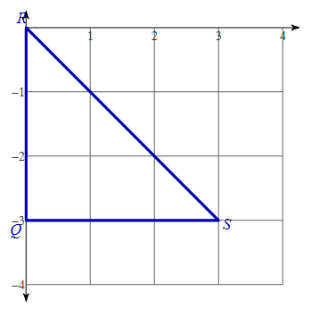
Special Segments $200
Find the coordinates of the circumcenter:

Slide 25
Special Segments $200 Answer
Draw the perpendicular bisectors: (1.5,-1.5)

Slide 26
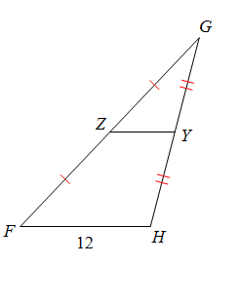
Special Segments $300
Find the length of ZY. What is ZY called? How do you know?

Slide 27
Special Segments $300 Answer
ZY = 6. ZY is a midsegment because it is created by joining the midpoints of 2 sides of a triangle.

Slide 28
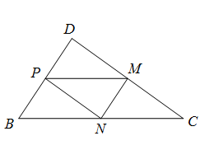
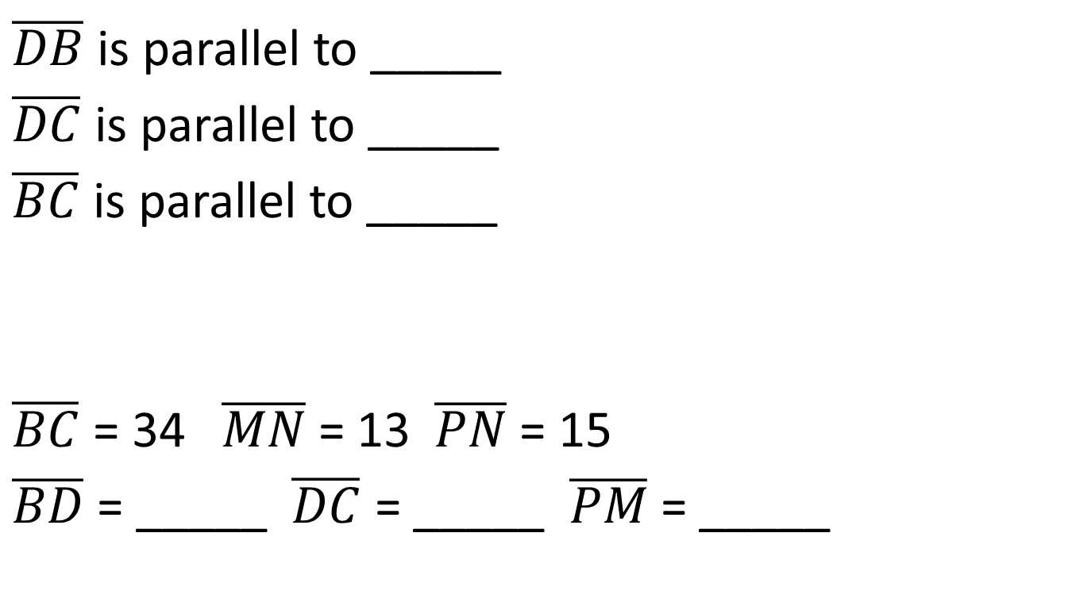
Special Segments $400
$\overline{DB}$ is parallel to _____
$\overline{DC}$ is parallel to _____
$\overline{BC}$ is parallel to _____
$\overline{BC}$ = 34 $\overline{MN}$ = 13 $\overline{PN}$ = 15
$\overline{BD}$ = _____ $\overline{DC}$ = _____ $\overline{PM}$ = _____

Slide 29
Special Segments $400 Answer
$\overline{DB}$ is parallel to $\overline{MN}$
$\overline{DC}$ is parallel to $\overline{PN}$
$\overline{BC}$ is parallel to $\overline{PM}$
$\overline{BC}$ = 34 $\overline{MN}$ = 13 $\overline{PN}$ = 15
$\overline{BD}$ = 26 $\overline{DC}$ = 30 $\overline{PM}$ = 17

Slide 30
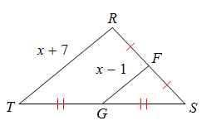
Special Segments $500
Solve for x:

Slide 31
Special Segments $500 Answer
Double the shorter segment
2(x – 1) = x + 7
2x – 2 = x + 7
x – 2 = 7 (subtract x)
x = 9 (add 2 to both sides)

Slide 32
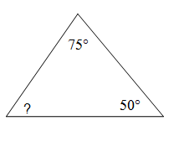
Angles $100
Solve for the ?:

Slide 33
Angles $100 Answer
Add the angles and subtract from 180:
75 + 50 = 125
180 – 125 = 55

Slide 34
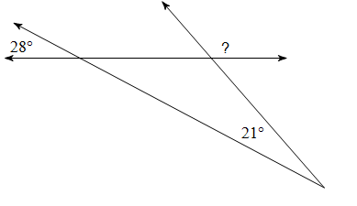
Angles $200
Solve for the ?:

Slide 35
Angles $200 Answer
Bring the vertical angle measurements inside the triangle
28 + 21 = 49
180 – 49 = 131

Slide 36
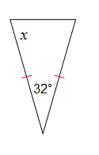
Angles $300
Solve for x:

Slide 37
Angles $300 Answer
180 – 32 = 148
148/2 = 74

Slide 38
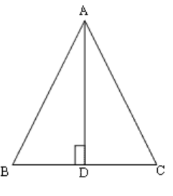

Angles $400
Given: $\overline{AB}$ = 21, $\overline{BC}$ = 18, m$∠$B = 65
$\overline{AC}$ = __ m$∠C$ = __ m$∠$BAC = __ m$∠$BAD = __ m$∠CAD$ = ___

Slide 39
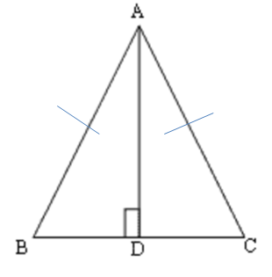

Angles $400 Answer
Given: $\overline{AB}$ = 21, $\overline{BC}$ = 18, m$∠$B = 65
$\overline{AC}$ = 21 m$∠C$ = 65 m$∠$BAC = 50 m$∠$BAD = 25 m$∠CAD$ = 25

Slide 40
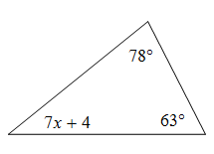
Angles $500
Solve for x:

Slide 41
Angles $500 Answer
78 + 63 + 7x + 4 = 180
7x + 145 = 180
7x = 35 (subtract 145)
x = 5 (divide by 7)

Slide 42
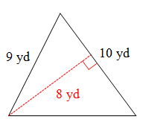
Area/P.T. $100
Find the area of the triangle:

Slide 43
Area/P.T. $100 Answer
A = ½ bh
A = ½ (10)(8)
A = 40 yd²

Slide 44
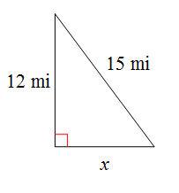
Area/P.T. $200
Solve for x:

Slide 45
Area/P.T. $200 Answer
x² + 12² = 15²
x² + 144 = 225
x² = 81
x = 9

Slide 46
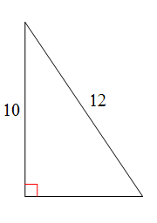
Area/P.T. $300
Find the area of the triangle:

Slide 47
Area/P.T. $300 Answer
A = ½ bh h = 10 we need the base
b² + 10² = 12²
b² + 100 = 144
b² = 44
b = 6.633
A = ½ (6.633)(10)
A = 33.165 = 33.2 units²

Slide 48
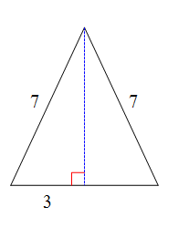
Area/P.T. $400
Find the area of the triangle. What kind of triangle is this? How can you tell?

Slide 49
Area/P.T. $400 Answer
The triangle is isosceles because of the two congruent legs with length 7. This also means the other bottom piece = 3, for a base of 6.
We need the height:
3² + h² = 7²
9 + h² = 49
h² = 40
h = 6.324
A = ½ (6)(6.324) = 18.972 = 19 units²

Slide 50
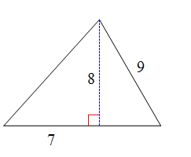
Area/P.T. $500
Find the area of the triangle:

Slide 51
Area/P.T. $500 Answer
A = ½ bh h = 8 part of base = 7, we need the other part:
X² + 8² = 9²
X² + 64 = 81
X² = 17
X = 4.123
Base = 7 + 4.123 = 11.123
A = ½ (11.123)(8) = 44.492 = 44.5 units²

Slide 52
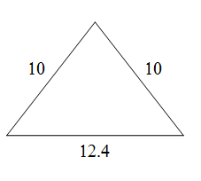
Final Jeopardy
Find the area of the triangle:

Slide 53
Final Jeopardy Answer
The triangle is isosceles. Draw in the height:
H² + 6.2² = 10²
H² + 38.44 = 100
H² = 61.56
H = 7.846
A = ½ (12.4)(7.846)
A = 48.6452 = 48.6 units²

